Slide 1
Fair and efficient online allocations
Gerdus Benadè
benade@bu.edu

Slide 2






Can we fairly and efficiently allocate goods online?
Organs
Ads
Vaccines
Food
Compute
Notes:
EF achievable. EF1 for indivisible. We similarly relax envy – how does it grow?
PO: approximation alpha PO if /1alpha undominatrd
Picture depends on value assumptions

Slide 3

Can we fairly and efficiently allocate goods online?
Organs
Ads
Vaccines
Food
Compute
Notes:
EF achievable. EF1 for indivisible. We similarly relax envy – how does it grow?
PO: approximation alpha PO if /1alpha undominatrd
Picture depends on value assumptions

Slide 4
Food insecurity and waste is common
USDA data on incidence of food insecurity in 2022 say:
12.8% of U.S. households
14.1% of global households
USDA estimates:
31% of all food in the US is wasted somewhere along the supply chain
92 billion lbs of food
Food rescue tries to address both issues at once
Match organizations with excess food to organizations that can distribute it where needed, in a timely manner
Notes:
ReFED (a nonprofit dedicated to fight food loss and waste)
Strengthening food rescue is among the seven key action areas they advocates for the next ten year

Slide 5





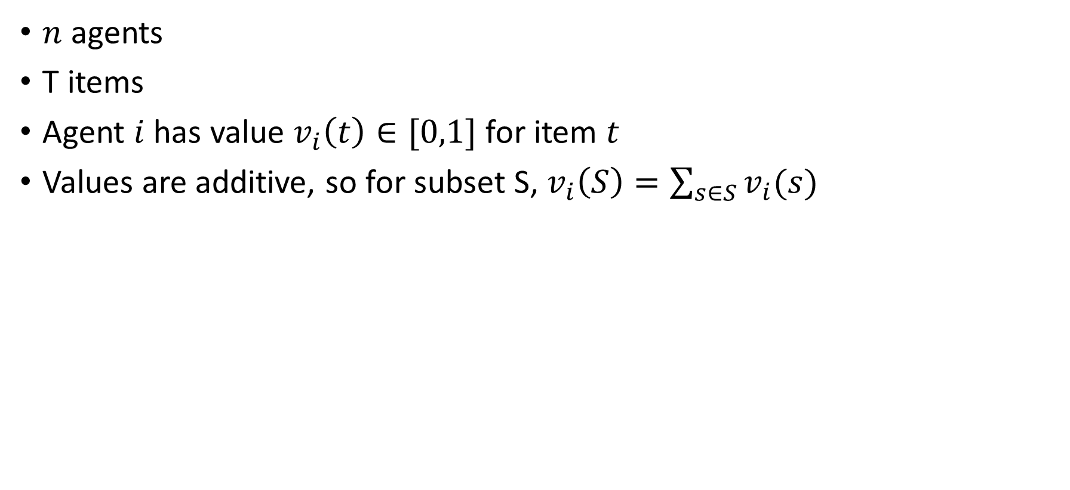
Static fair division
$n$ agents
T items
Agent $i$ has value $v_{i}\left(t\right)∈[0,1]$ for item $t$
Values are additive, so for subset S, $v_{i}\left(S\right)=\sum_{s∈S}{v_{i}(s)}$
1 | 1 | 0.5
0.9 | 0 | 0.3

Slide 6
Static fair division
$n$ agents
T items
Agent $i$ has value $v_{i}\left(t\right)∈[0,1]$ for item $t$
Values are additive, so for subset S, $v_{i}\left(S\right)=\sum_{s∈S}{v_{i}(s)}$
1 | 1 | 0.5
0.9 | 0 | 0.3

Slide 7
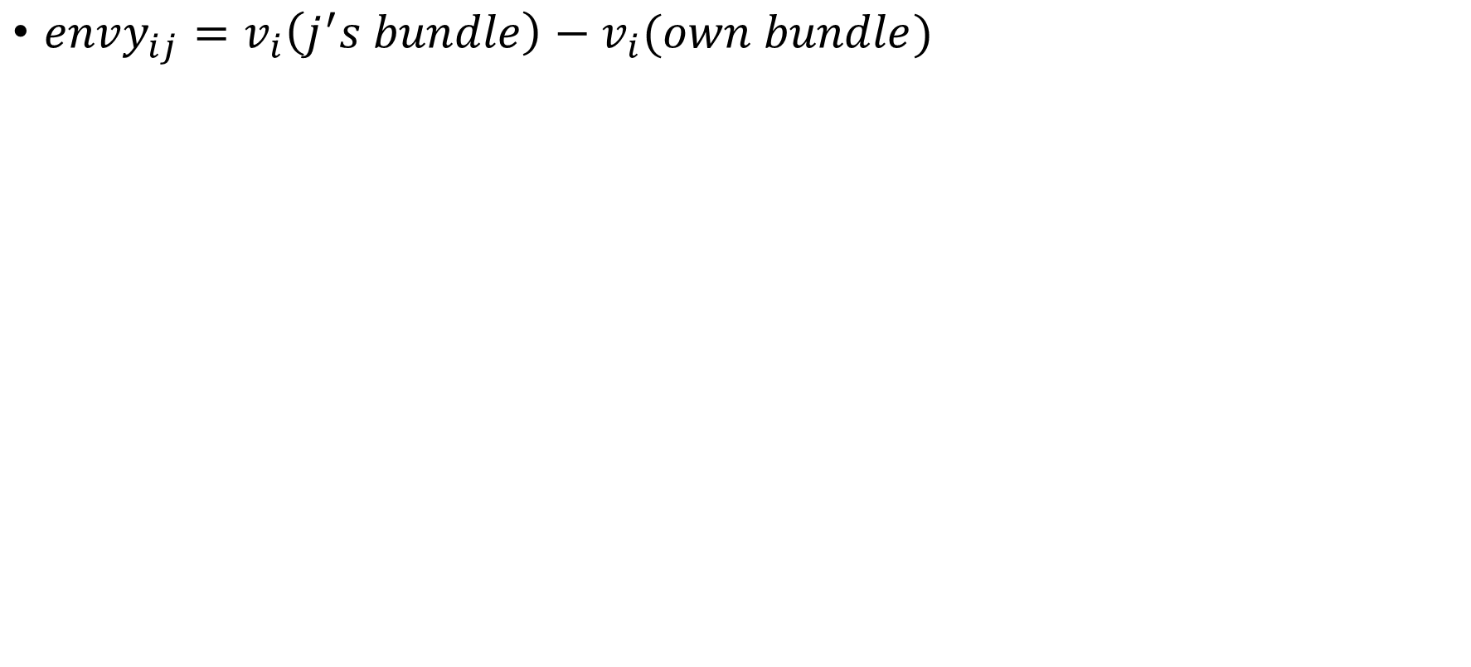
Static fair division – envy-freeness
$envy_{ij}=v_{i}\left(j^{′}s bundle\right)−v_{i}(own bundle)$
1 | 1 | 0.5
0.9 | 0 | 0.3

Slide 8
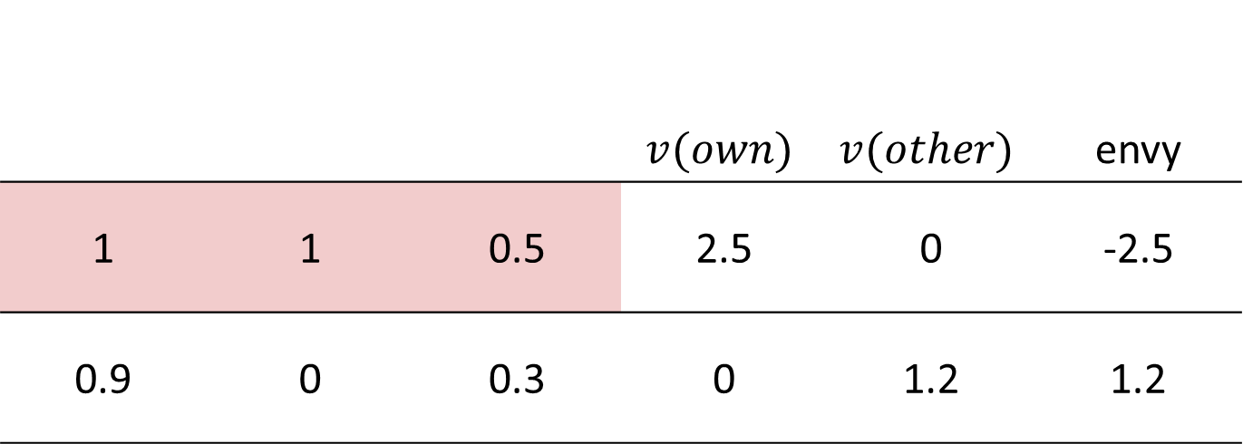
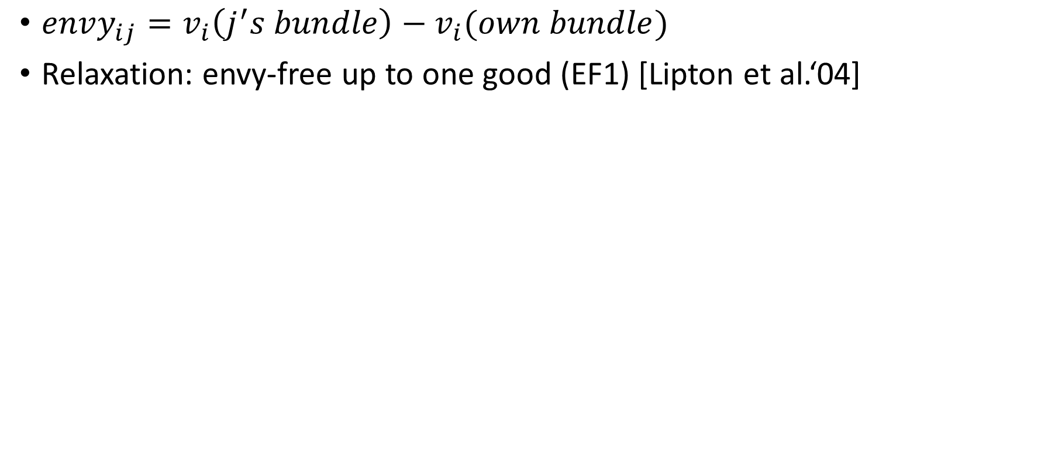
Static fair division – envy-freeness
$envy_{ij}=v_{i}\left(j^{′}s bundle\right)−v_{i}(own bundle)$
Relaxation: envy-free up to one good (EF1) [Lipton et al.‘04]
 |  |  | $$v(own)$$ | $$v(other)$$ | envy
1 | 1 | 0.5 | 2.5 | 0 | -2.5
0.9 | 0 | 0.3 | 0 | 1.2 | 1.2

Slide 9
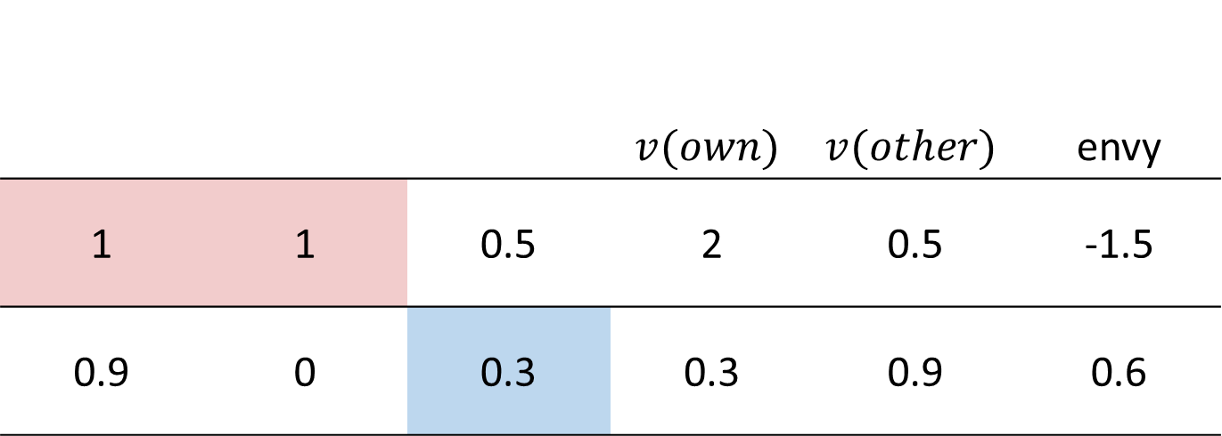
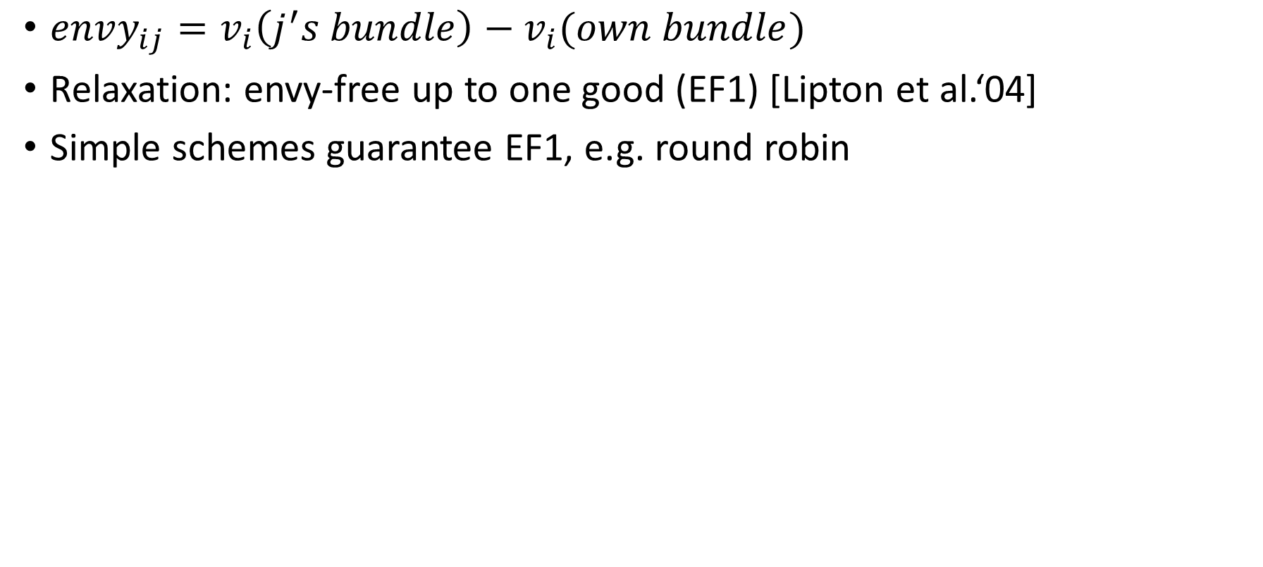
Static fair division – envy-freeness
$envy_{ij}=v_{i}\left(j^{′}s bundle\right)−v_{i}(own bundle)$
Relaxation: envy-free up to one good (EF1) [Lipton et al.‘04]
Simple schemes guarantee EF1, e.g. round robin
 |  |  | $$v(own)$$ | $$v(other)$$ | envy
1 | 1 | 0.5 | 2 | 0.5 | -1.5
0.9 | 0 | 0.3 | 0.3 | 0.9 | 0.6

Slide 10
Static fair division – envy-freeness
$envy_{ij}=v_{i}\left(j^{′}s bundle\right)−v_{i}(own bundle)$
Relaxation: envy-free up to one good (EF1) [Lipton et al.‘04]
Simple schemes guarantee EF1, e.g. round robin
 |  |  | $$v(own)$$ | $$v(other)$$ | envy
1 | 1 | 0.5 | 2 | 0.5 | -1.5
0.9 | 0 | 0.3 | 0.3 | 0.9 | 0.6
0
-0.3

Slide 11
Static fair division – envy-freeness
$envy_{ij}=v_{i}\left(j^{′}s bundle\right)−v_{i}(own bundle)$
Relaxation: envy-free up to one good (EF1) [Lipton et al.‘04]
Simple schemes guarantee EF1, e.g. round robin

Slide 12
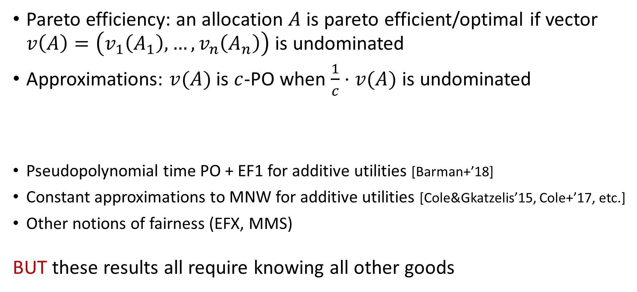
Efficiency
Pareto efficiency: an allocation $A$ is pareto efficient/optimal if vector $v\left(A\right)=\left(v_{1}\left(A_{1}\right), …, v_{n}\left(A_{n}\right)\right)$ is undominated
Approximations: $v(A)$ is $c$-PO when $\frac{1}{c}⋅v(A)$ is undominated
Pseudopolynomial time PO + EF1 for additive utilities [Barman+’18]
Constant approximations to MNW for additive utilities [Cole&Gkatzelis’15, Cole+’17, etc.]
Other notions of fairness (EFX, MMS)
BUT these results all require knowing all other goods
Theorem [Caragiannis et al.’19] The integral solution maximizing the product of utilities (Nash welfare) is Pareto efficient and EF1 for additive utilities

Slide 13
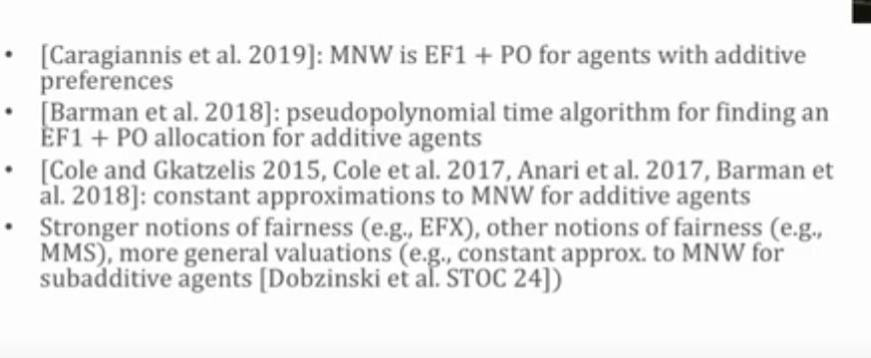

Slide 14
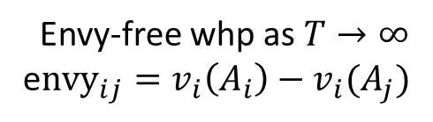
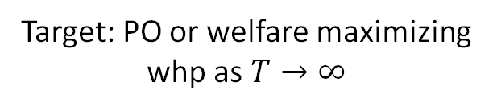
Can we fairly and efficiently allocate goods online?
Envy-free whp as $T→∞$
e$nvy_{ij}=v_{i}\left(A_{i}\right)−v_{i}(A_{j})$
Target: PO or welfare maximizing whp as $T→∞$
Notes:
EF achievable. EF1 for indivisible. We similarly relax envy – how does it grow?
PO: approximation alpha PO if /1alpha undominatrd
Picture depends on value assumptions

Slide 15


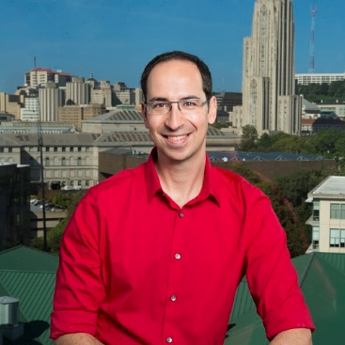

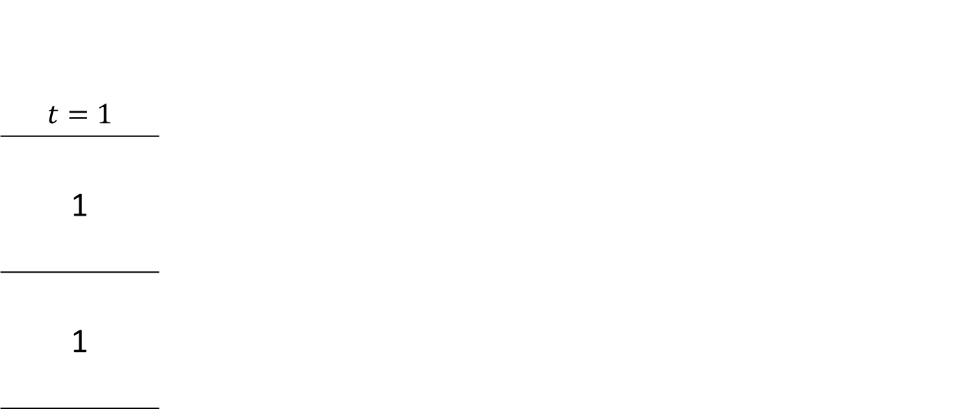
Online fair division
Agents are static, items arrive online [BKPP EC’18, BKPPZ OR’23]
$$t=1$$
1
1
Notes:
Adversarial values

Slide 16
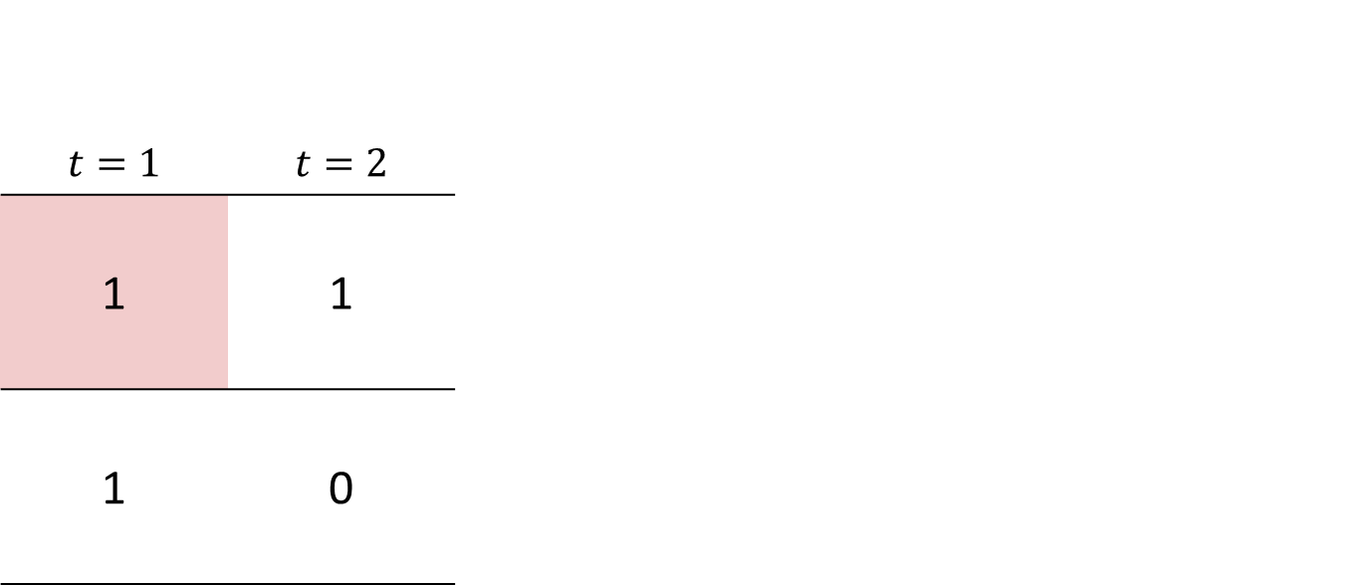
Online fair division
Agents are static, items arrive online
$$t=1$$ | $$t=2$$
1 | 1
1 | 0
Notes:
Adversarial values

Slide 17
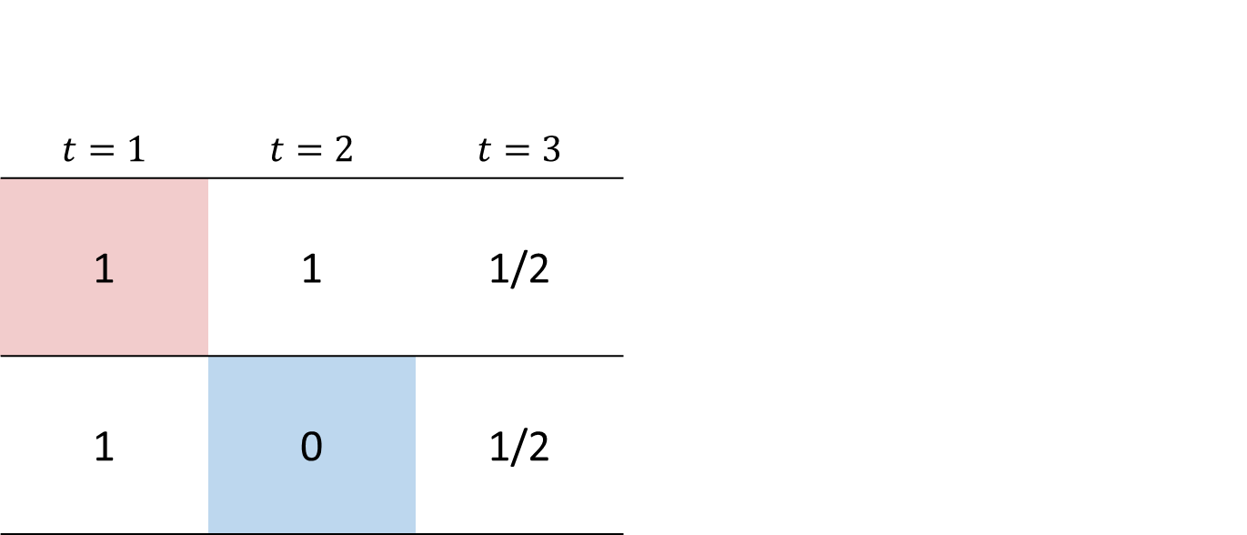
Online fair division
Agents are static, items arrive online
$$t=1$$ | $$t=2$$ | $$t=3$$
1 | 1 | 1/2
1 | 0 | 1/2
Notes:
Adversarial values

Slide 18
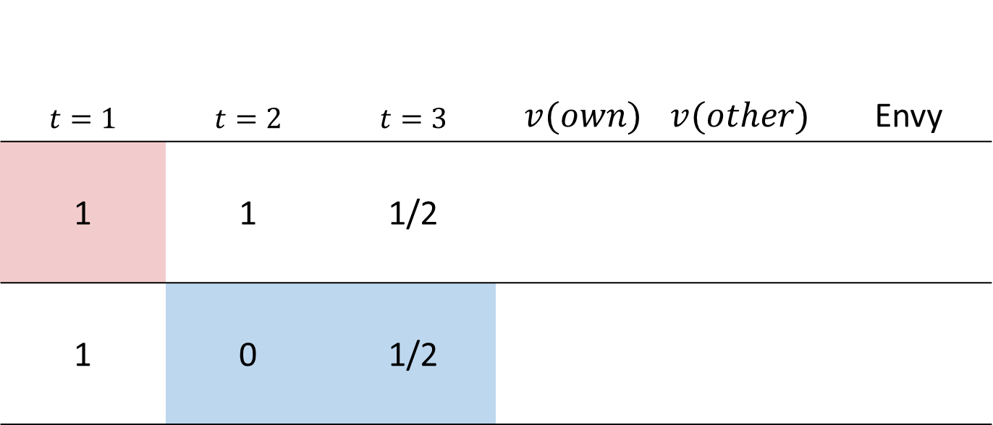
Online fair division
Agents are static, items arrive online
$$t=1$$ | $$t=2$$ | $$t=3$$ | $v(own)$ | $$v(other)$$ | Envy
1 | 1 | 1/2
1 | 0 | 1/2
Notes:
Adversarial values

Slide 19

Online fair division
Agents are static, items arrive online
$$t=1$$ | $$t=2$$ | $$t=3$$ | $v(own)$ | $$v(other)$$ | Envy
1 | 1 | 1/2 | 1 | 3/2 | 1/2
1 | 0 | 1/2 | 1/2 | 1 | 1/2
L
L
Notes:
Adversarial values

Slide 20
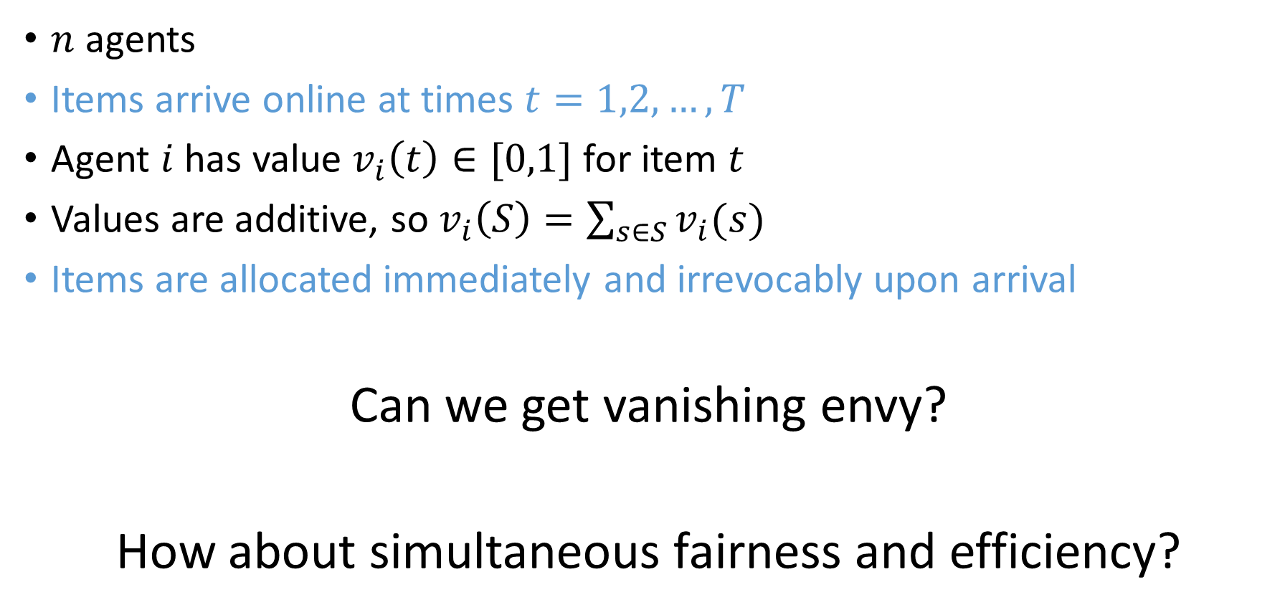
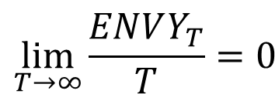
Online fair division
$n$ agents
Items arrive online at times $t=1,2,…, T$
Agent $i$ has value $v_{i}\left(t\right)∈[0,1]$ for item $t$
Values are additive, so $v_{i}\left(S\right)=\sum_{s∈S}{v_{i}(s)}$
Items are allocated immediately and irrevocably upon arrival
Can we get vanishing envy?
How about simultaneous fairness and efficiency?
$$\lim_{T→∞}{\frac{ENVY_{T}}{T}=0 }$$
Notes:
Some preliminary results about what happens with storage, reassignments etc

Slide 21
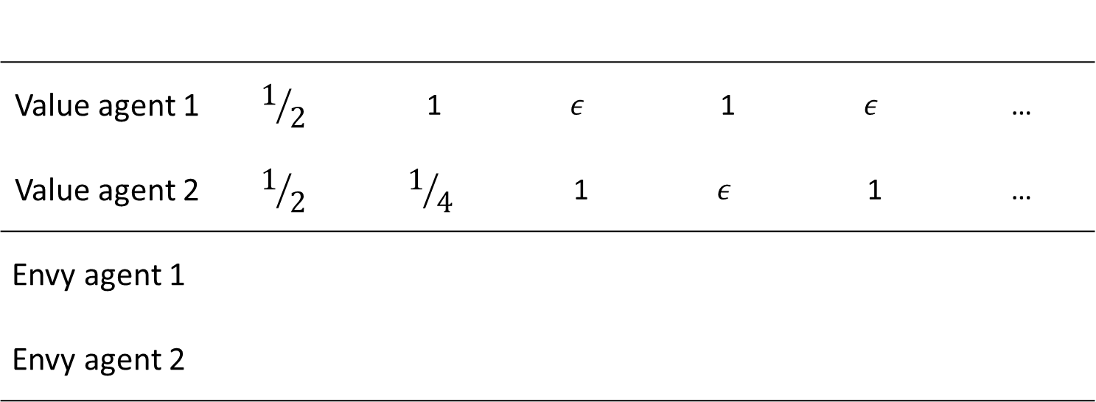
Obvious deterministic strategies fail
Give to whoever has the highest envy
Value agent 1 | $$1/2$$ | 1 | $$ε$$ | 1 | $$ε$$ | …
Value agent 2 | $$1/2$$ | $$1/4$$ | 1 | $$ε$$ | 1 | …
Envy agent 1
Envy agent 2
Notes:
Also to highest value

Slide 22
Obvious deterministic strategies fail
Give to whoever has the highest envy
Value agent 1 | $$1/2$$ | 1 | $$ε$$ | 1 | $$ε$$ | …
Value agent 2 | $$1/2$$ | $$1/4$$ | 1 | $$ε$$ | 1 | …
Envy agent 1
Envy agent 2

Slide 23
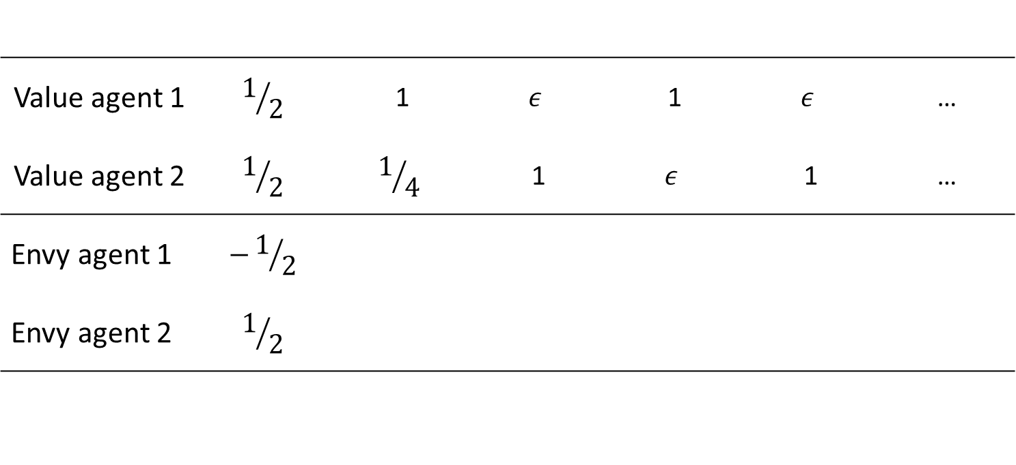
Obvious deterministic strategies fail
Give to whoever has the highest envy
Value agent 1 | $$1/2$$ | 1 | $$ε$$ | 1 | $$ε$$ | …
Value agent 2 | $$1/2$$ | $$1/4$$ | 1 | $$ε$$ | 1 | …
Envy agent 1 | $$−1/2$$
Envy agent 2 | $$1/2$$

Slide 24
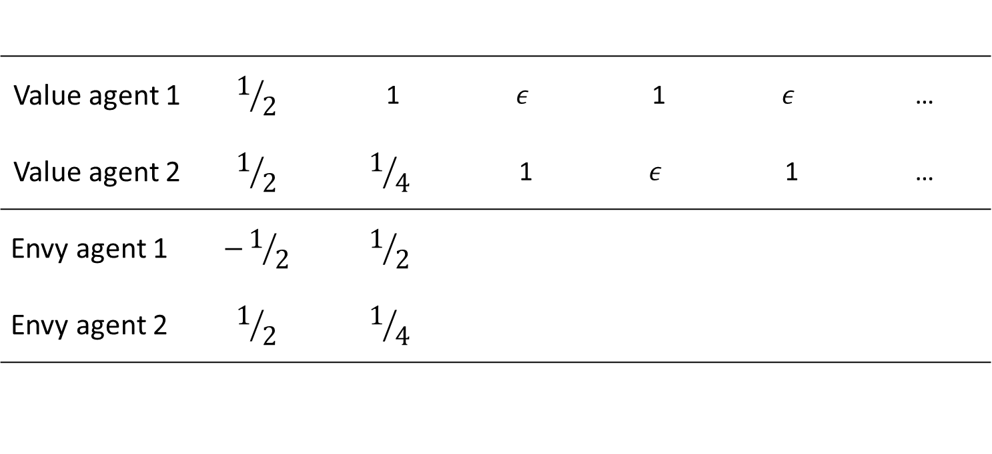
Obvious deterministic strategies fail
Give to whoever has the highest envy
Value agent 1 | $$1/2$$ | 1 | $$ε$$ | 1 | $$ε$$ | …
Value agent 2 | $$1/2$$ | $$1/4$$ | 1 | $$ε$$ | 1 | …
Envy agent 1 | $$−1/2$$ | $$1/2$$
Envy agent 2 | $$1/2$$ | $$1/4$$

Slide 25
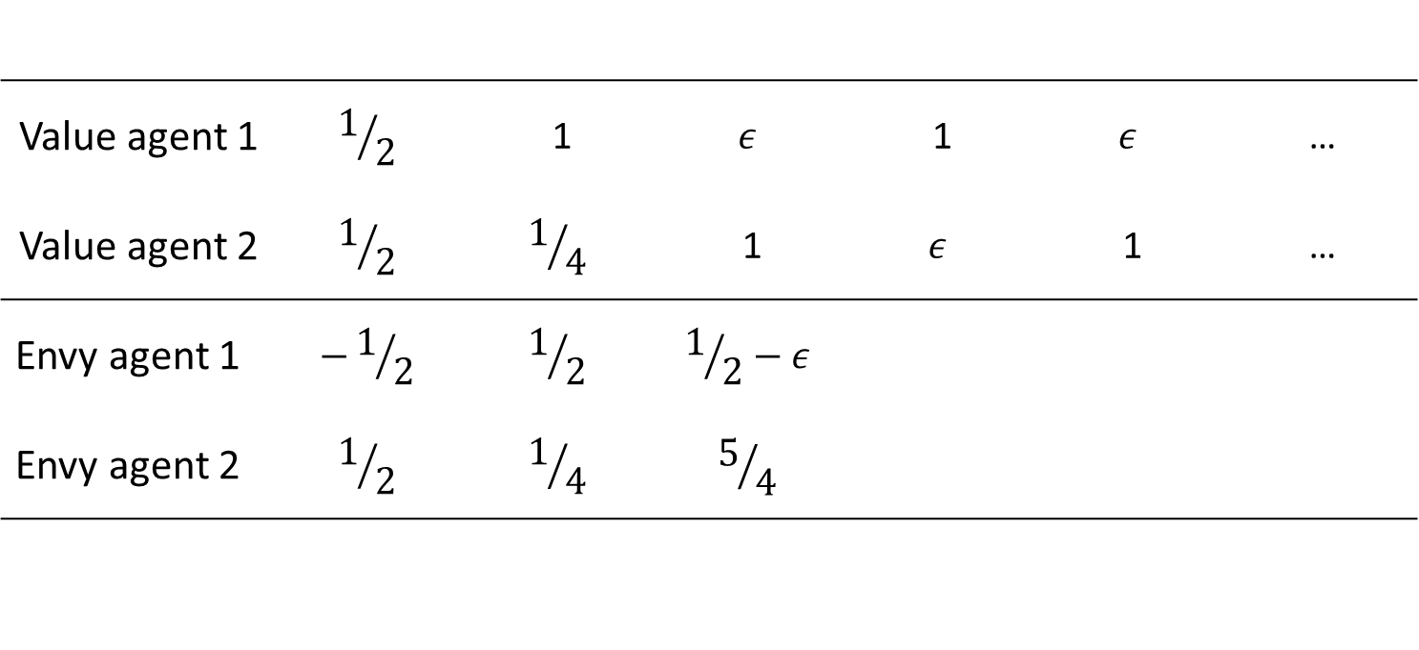
Obvious deterministic strategies fail
Give to whoever has the highest envy
Value agent 1 | $$1/2$$ | 1 | $$ε$$ | 1 | $$ε$$ | …
Value agent 2 | $$1/2$$ | $$1/4$$ | 1 | $$ε$$ | 1 | …
Envy agent 1 | $$−1/2$$ | $$1/2$$ | $$1/2−ε$$
Envy agent 2 | $$1/2$$ | $$1/4$$ | $$5/4$$

Slide 26
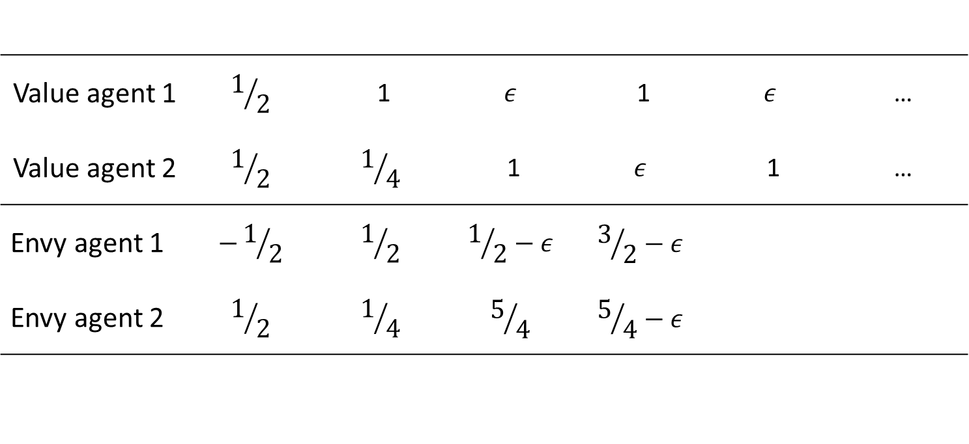
Obvious deterministic strategies fail
Give to whoever has the highest envy
Value agent 1 | $$1/2$$ | 1 | $$ε$$ | 1 | $$ε$$ | …
Value agent 2 | $$1/2$$ | $$1/4$$ | 1 | $$ε$$ | 1 | …
Envy agent 1 | $$−1/2$$ | $$1/2$$ | $$1/2−ε$$ | $$3/2−ε$$
Envy agent 2 | $$1/2$$ | $$1/4$$ | $$5/4$$ | $$5/4−ε$$

Slide 27
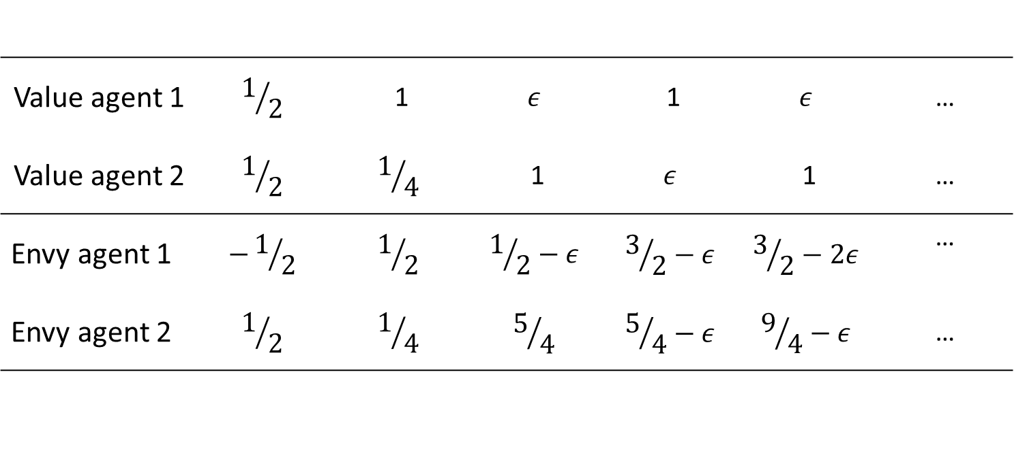
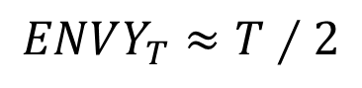
Obvious deterministic strategies fail
Give to whoever has the highest envy
Value agent 1 | $$1/2$$ | 1 | $$ε$$ | 1 | $$ε$$ | …
Value agent 2 | $$1/2$$ | $$1/4$$ | 1 | $$ε$$ | 1 | …
Envy agent 1 | $$−1/2$$ | $$1/2$$ | $$1/2−ε$$ | $$3/2−ε$$ | $$3/2−2ε$$ | …
Envy agent 2 | $$1/2$$ | $$1/4$$ | $$5/4$$ | $$5/4−ε$$ | $$9/4−ε$$ | …
$$ENVY_{T}≈T∕2$$
Notes:
Linear envy also for giving to highest value agent

Slide 28
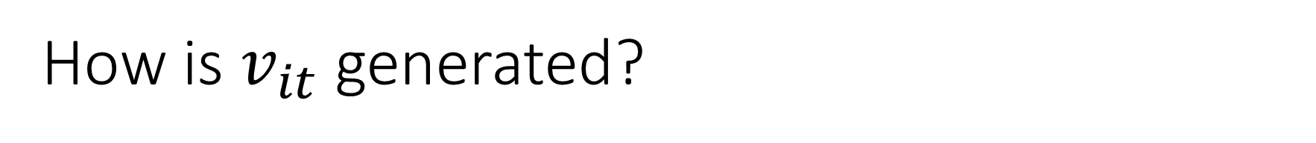
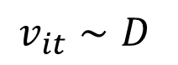
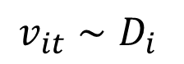
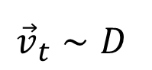
How is $v_{it}$ generated?
Bayesian adversaries: values drawn from distribution
Classical online algorithms
Weaker
Stronger
$$v_{it}∼D$$
$$v_{it}∼D_{i}$$
$${\vec{v}}_{t}∼D$$
Non-adaptive
adversary
Adaptive
adversary
Notes:
Standard adversaries on the right, Bayesian on the left values from a distrbution

Slide 29
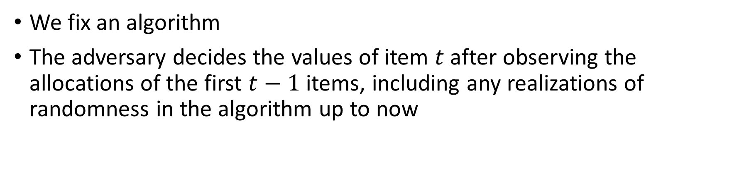
How is $v_{it}$ generated?
Bayesian adversaries: values drawn from distribution
Classical online algorithms
Weaker
Stronger
$$v_{it}∼D$$
$$v_{it}∼D_{i}$$
$${\vec{v}}_{t}∼D$$
Non-adaptive
adversary
Adaptive
adversary
We fix an algorithm
The adversary decides the values of item $t$ after observing the allocations of the first $t−1$ items, including any realizations of randomness in the algorithm up to now
Notes:
Standard adversaries on the right, Bayesian on the left values from a distrbution

Slide 30
How is $v_{it}$ generated?
Bayesian adversaries: values drawn from distribution
Classical online algorithms
Weaker
Stronger
$$v_{it}∼D$$
$$v_{it}∼D_{i}$$
$${\vec{v}}_{t}∼D$$
Non-adaptive
adversary
Adaptive
adversary
We fix an algorithm
The adversary decides item values after seeing the algorithm, but not the realizations of randomness in any step
Notes:
Standard adversaries on the right, Bayesian on the left values from a distrbution

Slide 31
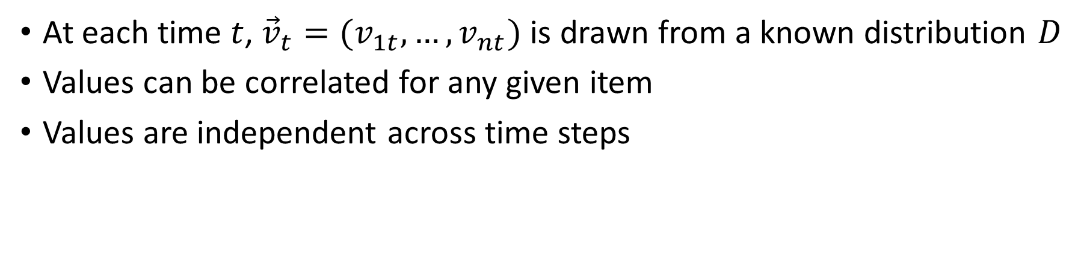
How is $v_{it}$ generated?
Bayesian adversaries: values drawn from distribution
Classical online algorithms
Weaker
Stronger
$$v_{it}∼D$$
$$v_{it}∼D_{i}$$
$${\vec{v}}_{t}∼D$$
Non-adaptive
adversary
Adaptive
adversary
At each time $t$, ${\vec{v}}_{t}=(v_{1t},…, v_{nt})$ is drawn from a known distribution $D$
Values can be correlated for any given item
Values are independent across time steps
Notes:
Standard adversaries on the right, Bayesian on the left values from a distrbution

Slide 32
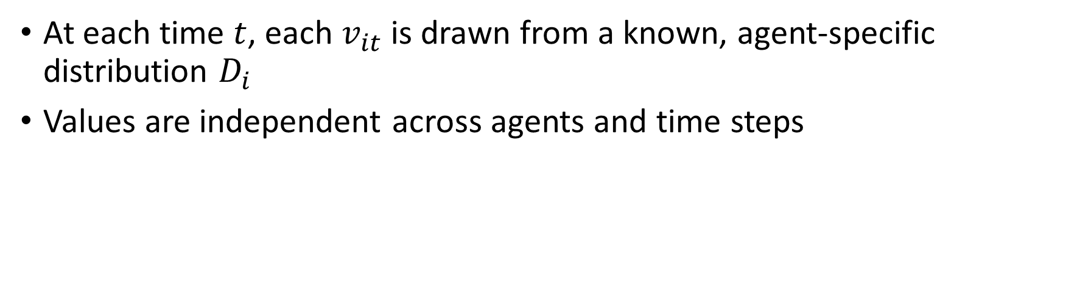
How is $v_{it}$ generated?
Bayesian adversaries: values drawn from distribution
Classical online algorithms
Weaker
Stronger
$$v_{it}∼D$$
$$v_{it}∼D_{i}$$
$${\vec{v}}_{t}∼D$$
Non-adaptive
adversary
Adaptive
adversary
At each time $t$, each $v_{it}$ is drawn from a known, agent-specific distribution $D_{i}$
Values are independent across agents and time steps
Notes:
Standard adversaries on the right, Bayesian on the left values from a distrbution

Slide 33
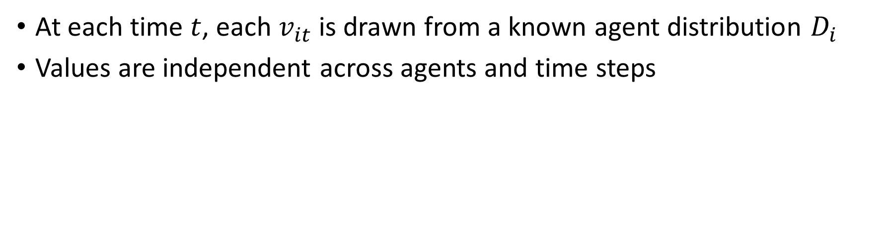
How is $v_{it}$ generated?
Bayesian adversaries: values drawn from distribution
Classical online algorithms
Weaker
Stronger
$$v_{it}∼D$$
$$v_{it}∼D_{i}$$
$${\vec{v}}_{t}∼D$$
Non-adaptive
adversary
Adaptive
adversary
At each time $t$, each $v_{it}$ is drawn from a known agent distribution $D_{i}$
Values are independent across agents and time steps
Notes:
Standard adversaries on the right, Bayesian on the left values from a distrbution

Slide 34
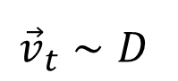
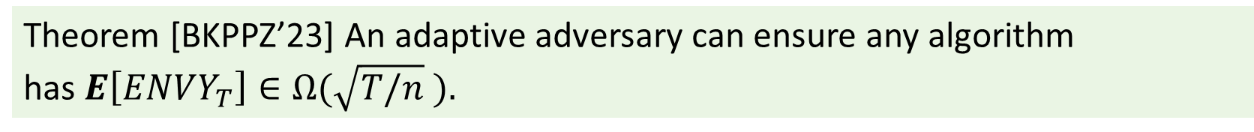
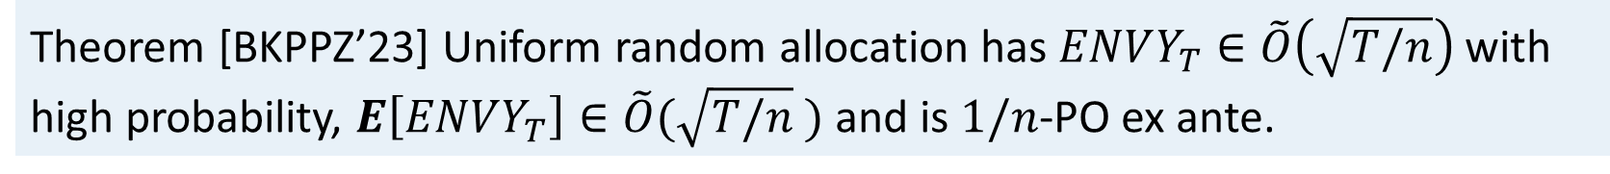
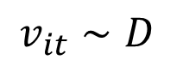
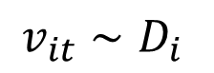
Adaptive adversary
$$v_{it}∼D$$
$$v_{it}∼D_{i}$$
$${\vec{v}}_{t}∼D$$
Non-adaptive
adversary
Adaptive
adversary
Algorithm: random allocation
Can we improve the efficiency?
Theorem [BKPPZ’23] Uniform random allocation has $ENVY_{T}∈\tilde{O}\left(\sqrt{T/n}\right)$ with high probability, $E\left[ENVY_{T}\right]∈\tilde{O}(\sqrt{T/n}$ ) and is $1/n$-PO ex ante.
Theorem [BKPPZ’23] An adaptive adversary can ensure any algorithm has$E\left[ENVY_{T}\right]∈Ω(\sqrt{T/n}$ ).
Notes:
Standard adversaries on the right, Bayesian on the left values from a distrbution

Slide 35
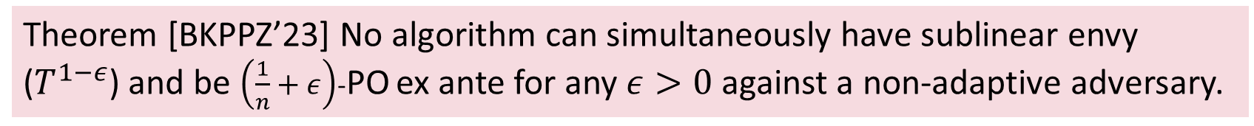
Non-adaptive adversary
$$v_{it}∼D$$
$$v_{it}∼D_{i}$$
$${\vec{v}}_{t}∼D$$
Non-adaptive
adversary
Adaptive
adversary
Can we improve the efficiency? NO
Sharp tradeoff, you get to have either fairness or efficiency but not both
Theorem [BKPPZ’23] No algorithm can simultaneously have sublinear envy ($T^{1−ε}$) and be $\left(\frac{1}{n}+ε\right)$-PO ex ante for any $ε>0$ against a non-adaptive adversary.
Notes:
Impossibility: for both randomized and deterministic against adaptive adversary
Extensions, delay small number of allocations, reallocate, etc

Slide 36
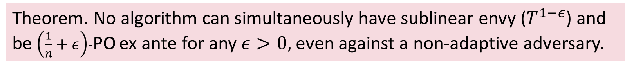
Non-adaptive adversary
$$v_{it}∼D$$
$$v_{it}∼D_{i}$$
$${\vec{v}}_{t}∼D$$
Non-adaptive
adversary
Adaptive
adversary
Can we improve the efficiency? NO
Sharp tradeoff, you get to have either fairness or efficiency but not both
Theorem. No algorithm can simultaneously have sublinear envy ($T^{1−ε}$) and be $\left(\frac{1}{n}+ε\right)$-PO ex ante for any $ε>0,$even against a non-adaptive adversary.
Notes:
Impossibility: for both randomized and deterministic against adaptive adversary
Extensions, delay small number of allocations, reallocate, etc

Slide 37
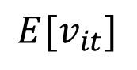
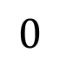
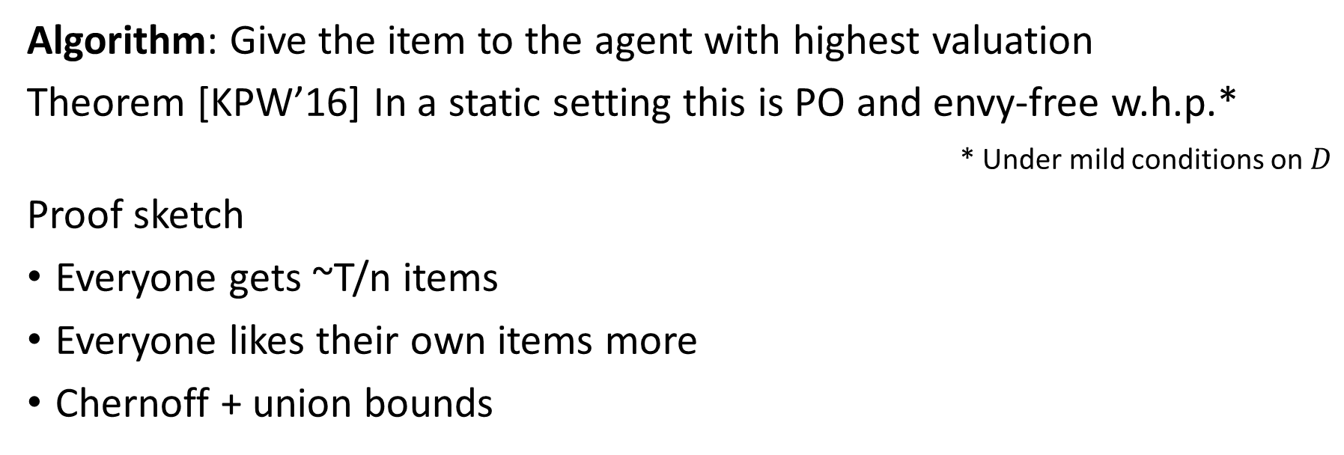
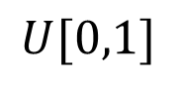

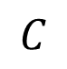
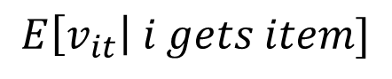
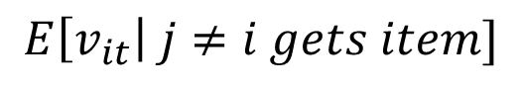
Independent and identical values
$$v_{it}∼D$$
$$v_{it}∼D_{i}$$
$${\vec{v}}_{t}∼D$$
Non-adaptive
adversary
Adaptive
adversary
Algorithm: Give the item to the agent with highest valuation
Theorem [KPW’16] In a static setting this is PO and envy-free w.h.p.*
* Under mild conditions on $D$
Proof sketch
Everyone gets ~T/n items
Everyone likes their own items more
Chernoff + union bounds
$$1$$
$$E\left[v_{it}\right| i gets item]$$
$$E[v_{it}]$$
$$C$$
$$E\left[v_{it}\right| j≠i gets item]$$
$$0$$
$$U[0,1]$$
Notes:
Not only for uniform, can replace with any distribution constant wrt T

Slide 38
Agent-specific distributions
$$v_{it}∼D$$
$$v_{it}∼D_{i}$$
$${\vec{v}}_{t}∼D$$
Non-adaptive
adversary
Adaptive
adversary
Extending greedy, proposal: Give item to the agent with highest quantile
Fails, U(0,1), U(.49,.51)
Envy-free with high probability, not efficient
[Bai&Golz’22] give an EF whp, PO and computationally efficient algorithm

Slide 39
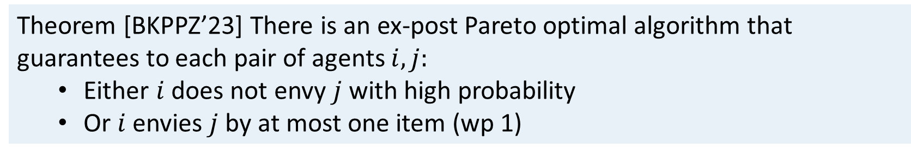
Correlated values
$$v_{it}∼D$$
$$v_{it}∼D_{i}$$
$${\vec{v}}_{t}∼D$$
Non-adaptive
adversary
Adaptive
adversary
Consider two identical agents: the best you can do is alternate per type
Substantially different agents are envy-free with high probability
Theorem [BKPPZ’23] There is an ex-post Pareto optimal algorithm that guarantees to each pair of agents $i,j:$
Either $i$ does not envy $j$ with high probability
Or $i$ envies $j$ by at most one item (wp 1)
Notes:
Identical up to scaling

Slide 40
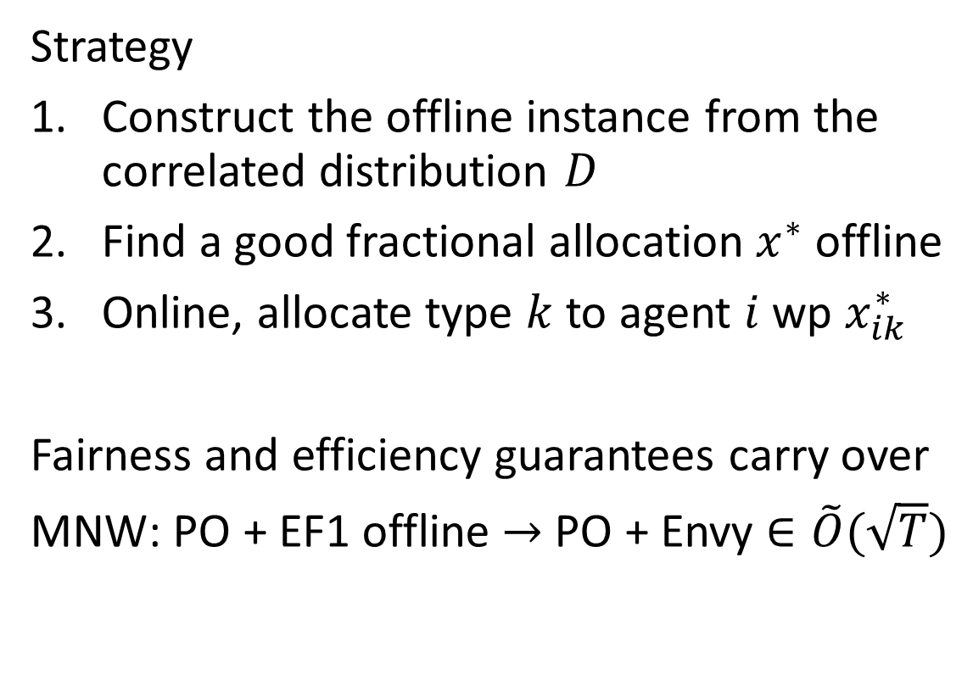
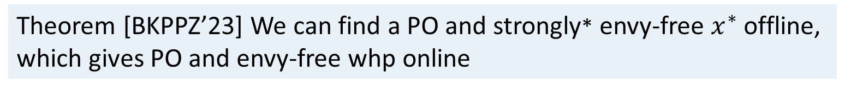
Intuition
2 | 1
1 | 2
Strategy
Construct the offline instance from the correlated distribution $D$
Find a good fractional allocation $x^{∗}$ offline
Online, allocate type $k$ to agent $i$ wp $x_{ik}^{∗}$
Fairness and efficiency guarantees carry over
MNW: PO + EF1 offline $→$ PO + Envy $∈\tilde{O}(\sqrt{T})$
Online
w.p. 0.2
w.p. 0.8
0.4 | 0.8
0.2 | 1.6
Offline
Theorem [BKPPZ’23] We can find a PO and strongly* envy-free $x^{∗}$ offline, which gives PO and envy-free whp online
Notes:
How can you be ex post pareto? Swap
Enough to be exante PO + fair in unrolled instance where values are multiplied by probabilities
ANY rounding of this is good
If $x^{∗}$ is PO, this results in a PO allocation,If $x^{∗}$ is strongly envy-free, this give EF whp
Strongly* ef – not quite: either identical allocations + identival valuations up to scaling for those items
OR strictly prefers their own bundle over everyone elses

Slide 41
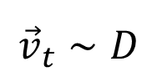


Fair and efficient online allocation
$$v_{it}∼D$$
$$v_{it}∼D_{i}$$
$${\vec{v}}_{t}∼D$$
Non-adaptive
adversary
Adaptive
adversary
BUT
People are bad at reporting values
Most organizations don’t elicit values
Notes:
Green: distribution independent of T. harder if it can depend on T, series of stoc/soda papers that study that problem by Bansal et al. much harder
Red, how do we escape. Eg models with predictions. Constrain adversary in some way, eg equal sum of values by T
Green, flex, make it more interesting. Reallocations, delay allocations, tell about one complication relevant to food rescue

Slide 42


Random allocation (really) works
.
Uniform random allocation is as good as it gets, in a sense
Only care about efficiency: give to agent with highest value
Extensions: delay allocations, reallocate [HPPZ’19], etc.
Theorem. Allocating items uniformly at random yields $ENVY_{T}∈\tilde{O}\left(\sqrt{T/n}\right)$ with high probability, $E\left[ENVY_{T}\right]∈\tilde{O}(\sqrt{T/n}$ ) and is $1/n$-PO ex ante.
Theorem. All algorithms have $E\left[ENVY_{T}\right]∈Ω(\sqrt{T/n}$ ).
Theorem. No algorithm can simultaneously have sublinear envy and be $\left(\frac{1}{n}+ε\right)$-PO ex ante for any $ε>0,$even against a non-adaptive adversary.
Notes:
Impossibility: for both randomized and deterministic against adaptive adversary

Slide 43

Bayesian setting
Independent values $v_{it}∼D_{i}$ [PZ19, BKPPZ22]
Core idea
[DKG+14] Allocating to agent with highest value is EF and WO whp ($T≥nlog n$)
Theorem. There is no fairness-efficiency tradeoff for iid values
Notes:
Arguments via concetration

Slide 44

Bayesian setting
Correlated values $v_{t}∼D$
Alg 1:
1. Find an EF + PO fractional allocation to the offline instance (MNW)
2. Use the fractional solution to guide the online allocations
No fairness-efficiency tradeoff in Bayesian settings
Lemma. Rounding a PO fractional allocation gives an ex post PO allocation
Lemma. Alg 1 is ex post PO. For $ε>0, ENVY_{T}^{ij}∈\tilde{O}\left(\sqrt{T/n}\right)$ w.p. at least $1−ε$
Theorem. Alg 1’ is ex post PO and, for $ε>0$, EF w.p. at least $1 −ε$
Notes:
Envy guarantee comes from EF in expectatiaon. Balls in bins argument shows within sqrt of expectation via concentration inequalities
If strictly EF, then the same arguments give EF whp
Random walk interpretation a bit better – EF means mean 0 RW, strictly EF means expectation (-),
General version: I’m lying a little: for each I, j (same values up to scaling) -> EF1; or different values and EF whp

Slide 45

Rethinking the model
A lot of behavioural work says people find it hard to report exact values (and are often inaccurate)
Computational social choice: Distortion measures loss from having access only to minimally expressive versions of utilities (Procaccia& Rosenschein’06)
$$\max_{\vec{v}:\vec{v}∇ρ}{}\frac{\max_{T}{sw(T, \vec{v})}}{sw(f\left(ρ\right), \vec{v})}$$
Practice: 412 Food rescue don’t elicit values (Shi+21), MEANS don’t, etc.
Notable exception: Feeding America – market system (Predergast’22)
Notes:
Market: artificial currency, bid everymorning, carryover etc. high volume, daily bids, some lead time.

Slide 46


Partial information [BHP Neurips’22, OR’24]
$n$ agents, items arrive online at times $t=1,2,…, T$
Items are allocated immediately and irrevocably upon arrival
Agent $i$ has value $v_{it}∈[0,1]$ for item $t$
Values are additive, so $v_{i}\left(S\right)=\sum_{s∈S}{v_{is}}$
Values $v_{it}$ drawn from continuous unknown distribution
You can query for an agent’s rank relative to a subset of previous items
Notes:
Adversarial values

Slide 47


Partial information
Values $v_{it}$ drawn from continuous unknown distribution, $Q_{it}$ is quantile
You can query for an agent’s rank relative to a subset of previous items
$$t=1$$
1
1
…
…
Notes:
Adversarial values

Slide 48

Partial information
Values $v_{it}$ drawn from continuous unknown distribution, $Q_{it}$ is quantile
You can query for an agent’s rank relative to a subset of previous items
$$t=1$$ | $$t=2$$
1 | 1-$ε$
1 | $ε$
>
…
Notes:
Adversarial values

Slide 49

Partial information
Values $v_{it}$ drawn from continuous unknown distribution, $Q_{it}$ is quantile
You can query for an agent’s rank relative to a subset of previous items
$$t=1$$ | $$t=2$$ | $$t=3$$
1 | 1-$ε$ | 1/2
1 | $ε$ | 1/2
>
>
Notes:
Adversarial values

Slide 50

Partial information
Values $v_{it}$ drawn from continuous unknown distribution, $Q_{it}$ is quantile
You can query for an agent’s rank relative to a subset of previous items
$$t=1$$ | $$t=2$$ | $$t=3$$ | $$v(own)$$ | $$v(other)$$ | Envy
1 | 1-$ε$ | 1/2
1 | $ε$ | 1/2
Notes:
Adversarial values

Slide 51

Partial information
Values $v_{it}$ drawn from continuous unknown distribution, $Q_{it}$ is quantile
You can query for an agent’s rank relative to a subset of previous items
$$t=1$$ | $$t=2$$ | $$t=3$$ | $$v(own)$$ | $$v(other)$$ | Envy
1 | 1-$ε$ | 1/2 | 1 | 3/2 - $ε$ | 1/2 - $ε$
1 | $ε$ | 1/2 | 1/2 + $ε$ | 1 | 1/2 - $ε$
L
L
Notes:
Adversarial values

Slide 52
Partial information
Values $v_{it}$ drawn from continuous unknown distribution, $Q_{it}$ is quantile
You can query for an agent’s rank relative to a subset of previous items
$$t=1$$ | $$t=2$$ | $$t=3$$ | $$v(own)$$ | $$v(other)$$ | Envy
1 | 1-$ε$ | 1/2 | 1 | 3/2 - $ε$ | 1/2 - $ε$
1 | $ε$ | 1/2 | 1/2 + $ε$ | 1 | 1/2 - $ε$
L
L
Notes:
Adversarial values

Slide 53

Independent and identical distributions
Ranking compared to a single previous item (High/Low reports)
Thm. In the iid setting with comparisons to a single item, we get a $\left(1−\frac{1}{e}\right)−ε$ $≈0.63$approximation to welfare and envy-freeness w.h.p., for all $ε>0$
Thm. With comparisons to a single item, no algorithm is 0.999 welfare maximizing with high probability for all distributions
Notes:
Analogue: QM. Alternative – much coarser quantile info, compares to a singke threshold.
strictly EF with constant gap is useful, we’ll make some mistakes.
Lem1: Analysis similar to Dickerson et al with slightly different technical assumptions
IID – QM is welfare optimal
n/(n-1): big errors when no one is above the threshold. 1 – (1-1/n)^n, which shows where 1-1/e comes from.
- Roughly 1/e prob of exactly one agent having high value, so any agent receives ~1/e fraction of their highest value items.
Goal – learn quantiles accurately enough : few mistakes + similar guarantees, for all distributions
-expl/expl: build constant envy gap when ranking, careful not to eliminate while sampling
-increasing epoch lengths: handle unknown distributions. Any fixed sampling phase, some distribution where this is not enough
Dvoretzky–Kiefer–Wolfowitz
Epsilon accurate – DKW inequality: empirical CDF concentrates around true exponentially quickly: for all agents – union bounds
Mistakes –first epochs, all sampling phases, wp eps in rank (1-delta), all rank (delta)
Great – partial info, guarantees that are tight and very similar to full information case.
Welfare approx. – NEEDED – nothing can be even oneswap PO perfectly
Rank relative to many items – binary search, T-> infty, annoying.
start by assuming you cant give a true value, then it is a little weird to as for a position in a ranking (quantile)
Sampling phase: allocate randomly. estimate benchmark quantile from H/L, keep for exploit phase if “close enough” to $1−\frac{1}{n} ,$ o.w. reject and repeat
Exploit phase: Run $q$-threshold with the benchmarks – randomize among agents who report the new item’s value is higher than benchmark.
Other tricks: Increasing epoch lengths, tightening definition of “close enough” since it has to work for every distribution
You can do no better than a constant approximation to envy with bounded memory

Slide 54



Extensions
Non-iid values $v_{it}∼D_{i}$
Ranking relative to arbitrary set of previous items
IID values
Correlated values, $v_{it}=v_{t}+ε_{it}$ with $v_{t}∼D, ε_{it}∼D_{noise}$
Thm. In the non-iid setting, even with a single comparison, you can get a $\left(1−\frac{1}{e}−ε\right)≈0.63$-Pareto efficient and envy free whp algorithm, for all $ε>0$
Thm. In the non-iid setting, no algorithm is envy-free and c-Pareto optimal with probability p, for $c>\frac{1+\sqrt{5}}{4}≈0.81$, $p>2/3$.
Thm. In the iid model, we guarantee EF and $\left(1−ε\right)$-welfare maximizing whp, $∀ε>0$
Thm. We provide an algorithm that is envy-free and $\left(1−ε\right)$-WO whp, $∀ε>0.$
Notes:
Non-iid – small gap
Flexible analysis tools, variety of settings. Various levels of robustness checks in different variants

Slide 55

Independent and identical distributions
Ranking relative to arbitrary set of previous items
Ranking compared to a single previous item (High/Low reports)
Thm. In the iid model, we guarantee EF and $\left(1−ε\right)$-welfare maximizing whp, $∀ε>0$
Thm. In the iid setting with comparisons to a single item, we get a $\left(1−\frac{1}{e}\right)−ε$ $≈0.63$approximation to welfare and envy-freeness w.h.p., for all $ε>0$
Thm. With comparisons to a single item, no algorithm is 0.999 welfare maximizing with high probability for all distributions
Notes:
Analogue: QM. Alternative – much coarser quantile info, compares to a singke threshold.
strictly EF with constant gap is useful, we’ll make some mistakes.
Lem1: Analysis similar to Dickerson et al with slightly different technical assumptions
IID – QM is welfare optimal
n/(n-1): big errors when no one is above the threshold. 1 – (1-1/n)^n, which shows where 1-1/e comes from.
- Roughly 1/e prob of exactly one agent having high value, so any agent receives ~1/e fraction of their highest value items.
Goal – learn quantiles accurately enough : few mistakes + similar guarantees, for all distributions
-expl/expl: build constant envy gap when ranking, careful not to eliminate while sampling
-increasing epoch lengths: handle unknown distributions. Any fixed sampling phase, some distribution where this is not enough
Dvoretzky–Kiefer–Wolfowitz
Epsilon accurate – DKW inequality: empirical CDF concentrates around true exponentially quickly: for all agents – union bounds
Mistakes –first epochs, all sampling phases, wp eps in rank (1-delta), all rank (delta)
Great – partial info, guarantees that are tight and very similar to full information case.
Welfare approx. – NEEDED – nothing can be even oneswap PO perfectly
Rank relative to many items – binary search, T-> infty, annoying.
start by assuming you cant give a true value, then it is a little weird to as for a position in a ranking (quantile)
Sampling phase: allocate randomly. estimate benchmark quantile from H/L, keep for exploit phase if “close enough” to $1−\frac{1}{n} ,$ o.w. reject and repeat
Exploit phase: Run $q$-threshold with the benchmarks – randomize among agents who report the new item’s value is higher than benchmark.
Other tricks: Increasing epoch lengths, tightening definition of “close enough” since it has to work for every distribution
You can do no better than a constant approximation to envy with bounded memory

Slide 56



Extensions
Correlated values, $v_{it}=v_{t}+ε_{it}$ with $v_{t}∼D, ε_{it}∼D_{noise}$
Non-iid values, $v_{it}∼D_{i}$
Thm. We provide an algorithm that is envy-free and $\left(1−ε\right)$-WO whp, $∀ε>0.$
Thm. In the non-iid setting, even with a single comparison, you can get a $\left(1−\frac{1}{e}−ε\right)≈0.63$-Pareto efficient and envy free whp algorithm, for all $ε>0$
Thm. In the non-iid setting, no algorithm is envy-free and c-Pareto optimal with probability p, for $c>\frac{1+\sqrt{5}}{4}≈0.81$, $p>2/3$.
Notes:
Non-iid – small gap
Flexible analysis tools, variety of settings. Various levels of robustness checks in different variants

Slide 57



The ideal: quantile-based algorithms
[DKG+14] Allocating to agent with highest value is EF and WO whp ($T≥nlog n$)
Quantile maximization (QM) alg.: Give to agent with highest quantile
$q$-threshold alg: Randomize among agents with $Q_{it}≥q$ ($q=\frac{n−1}{n}$)
Lemma. In both the iid and non-iid settings, QM and q-Thresh for $q=\frac{n−1}{n}$ are $c$-strongly envy-free whp, where $c$ depends on the distribution
Lemma. In the iid setting, $q$-Thresh for $q=\frac{n−1}{n}$ gives a ${\left(1−\frac{1}{e}\right)}^{2}−ε≈0.4$ approximation to welfare whp, for all $ε>0$
Notes:
Analogue: QM. Alternative – much coarser quantile info, compares to a singke threshold.
strictly EF with constant gap is useful, we’ll make some mistakes.
Lem1: Analysis similar to Dickerson et al with slightly different technical assumptions
IID – QM is welfare optimal
n/(n-1): big errors when no one is above the threshold. 1 – (1-1/n)^n, which shows where 1-1/e comes from.
- Roughly 1/e prob of exactly one agent having high value, so any agent receives ~1/e fraction of their highest value items.
Goal – learn quantiles accurately enough : few mistakes + similar guarantees, for all distributions

Slide 58




Unbounded memory
DKW ineq:
Def. A sample of $mn$ items is $ε$-accurate if QM gives a new item to the right agent wp $1−ε$.
QM is strongly EF and WO whp
Approximate QM with empirical quantiles
Analysis: allow sublinear number of mistakes compared to QM
Chosen to ensure $ε_{k}$-accuracy wp $1−δ_{k}$ via DKW inequality
Increasing epoch lengths
Exploit much longer than explore
Allocate to agent ranking item highest
compared to this sampling phase
Thm. In the iid model, Alg 1 is EF and $\left(1−ε\right)$-WO whp, for $ε>0.$
Notes:
-expl/expl: build constant envy gap when ranking, careful not to eliminate while sampling
-increasing epoch lengths: handle unknown distributions. Any fixed sampling phase, some distribution where this is not enough
Dvoretzky–Kiefer–Wolfowitz
Epsilon accurate – DKW inequality: empirical CDF concentrates around true exponentially quickly: for all agents – union bounds
Mistakes –first epochs, all sampling phases, wp eps in rank (1-delta), all rank (delta)
Great – partial info, guarantees that are tight and very similar to full information case.
Welfare approx. – NEEDED – nothing can be even oneswap PO perfectly

Slide 59


Thinking about memory
As sampling phases get longer, we ask for a rank relative to many items
Can we do better? What if we ask for comparison to only 1 prior item?
Bounded memory model
1 benchmark item per agent, report H/L for each new item
When allocating item, you may ‘store’ it and release old benchmark
Idea: sample for a good benchmark and run $1−\frac{1}{n}−$threshold
Thm. In the iid setting with comparisons to a single item, you get a ${\left(1−\frac{1}{e}\right)}^{2}−ε≈0.4$ approximation to welfare and EF w.h.p., for all $ε>0$
Notes:
Rank relative to many items – binary search, T-> infty, annoying.
start by assuming you cant give a true value, then it is a little weird to as for a position in a ranking (quantile)
Sampling phase: allocate randomly. estimate benchmark quantile from H/L, keep for exploit phase if “close enough” to $1−\frac{1}{n} ,$ o.w. reject and repeat
Exploit phase: Run $q$-threshold with the benchmarks – randomize among agents who report the new item’s value is higher than benchmark.
Other tricks: Increasing epoch lengths, tightening definition of “close enough” since it has to work for every distribution
You can do no better than a constant approximation to envy with bounded memory

Slide 60



Bounded memory
Thm. In the iid setting with 1 item memory, no algorithm is 0.999 welfare maximizing whp for all continuous and bounded distributions.
Strategy (Alg 2, informally):
Sampling phase: allocate randomly. estimate benchmark quantile from H/L, keep for exploit phase if “close enough” to $1−\frac{1}{n} ,$ o.w. reject and repeat
Exploit phase: Run $q$-threshold with the benchmarks – randomize among agents who report the new item’s value is higher than benchmark.
Other tricks: Increasing epoch lengths, tightening definition of “close enough” since it has to work for every distribution
Recall. In the iid setting, $q$-Thresh for $q=\frac{n−1}{n}$ gives a ${\left(1−\frac{1}{e}\right)}^{2}−ε≈0.4$ approximation to welfare w.h.p ., for all $ε>0$
Thm. In the iid setting with memory 1, Alg 2 gives a ${\left(1−\frac{1}{e}\right)}^{2}−ε≈0.4$ approximation to welfare and is EF w.h.p., for all $ε>0$
Notes:
Have good building block
Technical difficulties,
A lot of sampling, reasonable chance that not everyone finds a good benchmark
for all good benchmarks, not everyone has the same threshold
Gap to close.
Also works for non-iid: 0.37 form both mem1 + meminfty. Doesn’t get much worse. (0.37, 0.8)

Slide 61

Thm. In the iid model with unbounded memory, Alg 1 is EF and $\left(1−ε\right)$-WO whp
Recall. $\frac{n−1}{n}$-Thresh gives a ${\left(1−\frac{1}{e}\right)}^{2}−ε≈0.4$ approx to welfare w.h.p ., for all $ε>0$

Slide 62


Simulations
Without values you lose 10-100x more items
95th percentile welfare

Slide 63

Fairness, efficiency
Envy: does any agent prefer another’s allocation over their own?
$envy_{ij}=v_{i}\left(A_{j}\right)−v_{i}(A_{i})$
If no agent envies another the allocation is envy-free
A is Pareto optimal when there is no A’ where no-one is worse off and someone is strictly better off
Utility vector $v(A)$ is PO if there is no $v\left(A^{′}\right)$ dominating it
Approximate PO: $v(A)$ is $α$-PO when $\frac{1}{α}v(A)$ is undominated
Let $A^{∗}$ be a welfare optimal allocation, ie it maximizes $\sum_{i}{v_{i}(A_{i})}$
$A$ is an $α$-approximation to welfare when $\sum_{i}{v_{i}(A_{i})}≥α⋅\sum_{i}{v_{i}(A_{i}^{∗})}$
Notes:
Dividing resources fairly between agents with different preferences
Classical example non-homogeneous cake
envy: satisfied
With indivisible items, envy-free allocations need not exist

Slide 64

With known item values
Nothing known about non-adaptive
Adversarial values [BKPP18, BKPPZ22]
Random allocation has envy $O(\sqrt{T})$ whp (derandomize)
Every algorithm has envy $Ω(\sqrt{T})$ against an adaptive adversary
Fairness-Efficiency tradeoff: No alg with sublinear envy is more efficient than random allocation [PZ19, BKPPZ22]
Values drawn from a distribution [PZ19, BKPPZ22]
No fairness-efficiency tradeoff even for correlated values
Core idea from [DKG+14, KPW16]: For values drawn iid from some distribution, allocating each item to the agent with highest value is welfare optimal and EF whp (for more than $n\log{n}$ items)
Delay allocations (buy a fridge)
Allow reallocations
Beyond additive values
Notes:
Other things: what if you are allowed modifications, what if you can delay allocating a small number of items etc.
Another model: agents arrive, decide how much of pool to give them. Sid Banerjee has some work on this.
Enough background, ... Let’s take stock of where we are.

Slide 65

With known item values
Adversarial values [BKPP18, BKPPZ22]
Random allocation has envy $O(\sqrt{T})$ whp (derandomize)
Every algorithm has envy $Ω(\sqrt{T})$ against an adaptive adversary
Fairness-Efficiency tradeoff: No alg with sublinear envy is more efficient than random allocation [PZ19, BKPPZ22]
Values drawn from a distribution [PZ19, BKPPZ22]
No fairness-efficiency tradeoff even for correlated values
Core idea from [DKG+14, KPW16]: For values drawn iid from some distribution, allocating each item to the agent with highest value is welfare optimal and EF whp (for more than $n\log{n}$ items)
Notes:
Other things: what if you are allowed modifications, what if you can delay allocating a small number of items etc.
Another model: agents arrive, decide how much of pool to give them. Sid Banerjee has some work on this.
Enough background, ... Let’s take stock of where we are.

Slide 66



Can we fairly and efficiently allocate goods online, with only partial information?
Target: Envy-free whp as $T→∞$
Target: PO or welfare maximizing whp as $T→∞$
Value $v_{it}$ drawn iid on arrival from unknown continuous, bounded distribution
Agents report ranking of item relative to a subset of their bundle
Notes:
Why do we have any hope – start by showing that some forms of partial information is useful

Slide 67

A glimmer of hope: quantile-based algorithms
[DKG+14] Allocating to agent with highest value is EF and WO whp ($T≥nlog n$)
Quantile maximization (QM) alg.: Give to agent with highest quantile
$q$-threshold alg: Randomize among agents with $Q_{it}≥q$
Lemma. In both the iid and non-iid settings, QM and q-Thresh for $q=\frac{n−1}{n}$ are $c$-strongly envy-free whp, where $c$ depends on the distribution
Lemma. In the iid setting, $q$-Thresh for $q=\frac{n−1}{n}$ gives a ${\left(1−\frac{1}{e}\right)}^{2}−ε≈0.4$ approximation to welfare whp, for all $ε>0$
Notes:
Analogue: QM. Alternative – much coarser quantile info, compares to a singke threshold.
Use these as inspiration
strictly EF with constant gap is useful, we’ll make some mistakes.
Lem1: Analysis similar to Dickerson et al with slightly different technical assumptions
IID – QM is welfare optimal
n/(n-1): big errors when no one is above the threshold. 1 – (1-1/n)^n, which shows where 1-1/e comes from.
- Roughly 1/e prob of exactly one agent having high value, so any agent receives ~1/e fraction of their highest value items.
Goal – learn quantiles accurately enough : few mistakes + similar guarantees, for all distributions

Slide 68








IID model, unbounded memory
We need some approximation to welfare
Proof sketch (for U[0,1]): we know nothing about the first item
With some constant probability, we make a disastrous mistake
(1) PO requires all future items in $R_{1}$ go to ag. 1
(2) Ag. 2 has value $≥0.7tE\left[X\right]$ for such items whp
(3) Ag. 2’s total value $≤1.1tE\left[X\right]$ whp
When (1), (2) and (3) happen (with constant prob) the algorithm can not be EF
Thm. In the iid model for 2 agents, no algorithm is one-swap PO and EF w.h.p., even for values sampled from a known continuous and bounded distrib..
$$q_{2}$$
1
$$0.9$$
$$t$$
$$v_{2}$$
$$q_{1}$$
$$v_{1}$$
$$0.1$$
Notes:
Assume we give it to

Slide 69
Unbounded memory
We need some approximation to efficiency
Proof sketch (for U[0,1]): we know nothing about the first item
With some constant probability, we make a disastrous mistake
Thm. In the iid model for 2 agents, no algorithm is one-swap PO and EF w.h.p., even for values sampled from a known continuous and bounded distrib..
Notes:
We can do a lot with quantiles, and we can estimate quantiles, so we’re good!
Hang on a bit… we cant expect exact efficiency.
QM is welfare opt – cant even get one-swap PO

Slide 70
Unbounded memory
We need some approximation to efficiency
Proof sketch (for U[0,1]): we know nothing about the first item
With some constant probability, we make a disastrous mistake
Thm. In the iid model for 2 agents, no algorithm is one-swap PO and EF w.h.p., even for values sampled from a known continuous and bounded distrib..
$$q_{2}$$
1
$$0.9$$
$$v_{2}$$
$$q_{1}$$
$$v_{1}$$
$$0.1$$
Notes:
Assume we give it to

Slide 71


Unbounded memory
We need some approximation to welfare
Proof sketch (for U[0,1]): we know nothing about the first item
With some constant probability, we make a disastrous mistake
(1) PO requires all future items in $R_{1}$ go to ag. 1
(2) Ag. 2 has value $≥0.7tE\left[X\right]$ for such items whp
For U[0,1]: $E\left[v_{2}\left(R_{1}\right)\right]=0.81⋅t⋅0.45$
$=0.81⋅t⋅0.9 E\left[X\right]$
$≥0.72⋅t⋅E[X]$
Thm. In the iid model for 2 agents, no algorithm is one-swap PO and EF w.h.p., even for values sampled from a known continuous and bounded distrib..
$$q_{2}$$
1
$$0.9$$
$$R_{1}$$
$$t$$
$$v_{2}$$
$$q_{1}$$
$$v_{1}$$
$$0.1$$
Notes:
Assume we give it to

Slide 72
Unbounded memory
We need some approximation to welfare
Proof sketch (for U[0,1]): we know nothing about the first item
With some constant probability, we make a disastrous mistake
(1) PO requires all future items in $R_{1}$ go to ag. 1
(2) Ag. 2 has value $≥0.7tE\left[X\right]$ for such items whp
(3) Ag. 2’s total value $≤1.1tE\left[X\right]$ whp
When (1), (2) and (3) happen (with constant prob) the algorithm can not be EF
Thm. In the iid model for 2 agents, no algorithm is one-swap PO and EF w.h.p., even for values sampled from a known continuous and bounded distrib..
$$q_{2}$$
1
$$0.9$$
$$t$$
$$v_{2}$$
$$q_{1}$$
$$v_{1}$$
$$0.1$$
Notes:
Assume we give it to

Slide 73
Unbounded memory
DKW ineq:
Def. A sample of $mn$ items is $ε$-accurate if QM gives a new item to the right agent wp $1−ε$.
QM is strongly EF and WO whp
Approximate QM with empirical quantiles
Analysis: allow sublinear number of mistakes compared to QM
Chosen to ensure $ε_{k}$-accuracy wp $1−δ_{k}$ via DKW inequality
Increasing epoch lengths
Exploit much longer than explore
Allocate to agent ranking item highest
compared to this sampling phase
Thm. In the iid model, Alg 1 is EF and $\left(1−ε\right)$-WO whp, for $ε>0.$
Notes:
-expl/expl: build constant envy gap when ranking, careful not to eliminate while sampling
-increasing epoch lengths: handle unknown distributions. Any fixed sampling phase, some distribution where this is not enough
Dvoretzky–Kiefer–Wolfowitz
Epsilon accurate – DKW inequality: empirical CDF concentrates around true exponentially quickly: for all agents – union bounds
Mistakes –first epochs, all sampling phases, wp eps in rank (1-delta), all rank (delta)
Great – partial info, guarantees that are tight and very similar to full information case.

Slide 74

Thm. In the iid model, Alg 1 is EF and $\left(1−ε\right)$-WO whp, for $ε>0.$
Proof sketch: QM is $c$-strongly EF
$⇒ {envy}_{ij}^{QM}$ $≈− cT/n$ whp
$⇒$ EF if a sub-linear number mistakes
Mistakes compared to QM:
1. All of the first $3n−1$ epochs
2. Sampling phase of epoch $k≥3n$
3. Ranking phase of epoch $k≥3n, ε_{k}$-accurate (wp $1−δ_{k}$)
4. Ranking phase of epoch $k≥3n$, not $ε_{k}$-accurate (wp $δ_{k}$)
Check the total mistakes is sublinear in $T$ and confirm $(1−ε)$ WO
Notes:
Constant in T
~ sqrt(epoch length)
Pick phase lengths to control these terms – possible

Slide 75
Thinking about memory
Thm. In the iid model with unbounded memory, Alg 1 is EF and $\left(1−ε\right)$-WO whp
As sampling phases get longer, we ask for a rank relative to many items
Can we do better? What if we ask for comparison to only 1 prior item?
Bounded memory model
1 benchmark item per agent, report H/L for each new item
When allocating item, you may ‘store’ it and release old benchmark
Once an item is allocated and not stored or stored and subsequently released, it can not be made benchmark again
Notes:
Rank relative to many items – binary search, T-> infty, annoying.
start by assuming you cant give a true value, then it is a little weird to as for a position in a ranking (quantile)

Slide 76

Bounded memory, constant approximation
Proof sketch for $n=2$.
Assume values are drawn from U[0,1]. Let $q_{1},q_{2}$ be the quantiles of the benchmark item of agents 1, 2. Wlog assume $q_{1}≤q_{2}.$
Consider the intervals $\left[0,q_{1}\right], \left[q_{1},q_{2}\right], \left[q_{2}, 1\right].$ At least one is $≥1/3$
Suppose its $I=\left[q_{1},q_{2}\right]$. Item $t$ has $Q_{1t}∈I$ and $Q_{2t}∈I$ wp $≥1/9$
Conditioned on $t∈I$, $E[v_{high}−v_{low}]$ $≥$ 1/9, equally likely either
Any alg allocates to some agent wp at most ½ when in $I$
Expected loss per item: $\frac{1}{9}⋅\frac{1}{2}⋅\frac{1}{9}=\frac{1}{162}.$ Whp it concentrates, $≥\frac{1}{1000}$
Thm. In the iid setting with 1 item memory, no algorithm is 0.999 welfare maximizing whp for all continuous and bounded distributions.
Notes:
Has cost : Constant approx. is the best we can do
General n: quantiles are still unif01, set up the distribution so that there is a similar range of uncertainty

Slide 77

Bounded memory
Recall. In the iid setting, $q$-Thresh for $q=\frac{n−1}{n}$ gives a ${\left(1−\frac{1}{e}\right)}^{2}−ε≈0.4$ approximation to welfare w.h.p ., for all $ε>0$
Strategy (Alg 2, informally):
Sampling phase: allocate randomly. estimate benchmark quantile from H/L, keep for exploit phase if “close enough” to $1−\frac{1}{n} ,$ o.w. reject and repeat
Exploit phase: Run $q$-threshold with the benchmarks – randomize among agents who report the new item’s value is higher than benchmark.
Other tricks: Increasing epoch lengths, tightening definition of “close enough” since it has to work for every distribution
Thm. In the iid setting with memory 1, Alg 2 gives a ${\left(1−\frac{1}{e}\right)}^{2}−ε≈0.4$ approximation to welfare and is EF w.h.p., for all $ε>0$
Notes:
Have good building block
Technical difficulties,
A lot of sampling, reasonable chance that not everyone finds a good benchmark
for all good benchmarks, not everyone has the same threshold
Gap to close.
Also works for non-iid: 0.37 form both mem1 + meminfty. Doesn’t get much worse. (0.37, 0.8)

Slide 78



Can we fairly and efficiently allocate goods online?
$$v_{it}∼D$$
$$v_{it}∼D_{i}$$
$${\vec{v}}_{t}∼D$$
Non-adaptive
adversary
Adaptive
adversary
Notes:
Green: distribution independent of T. harder if it can depend on T, series of stoc/soda papers that study that problem by Bansal et al. much harder
Red, how do we escape. Eg models with predictions. Constrain adversary in some way, eg equal sum of values by T
Green, flex, make it more interesting
Tellstory – we don’t get to make the allocation, toss out these models

Slide 79

Achieving Rawlsian fairness in food rescue
Gerdus Benade (benade@bu.edu)
With Aydin Alptekinoglu

Slide 80

Setting: a national food rescue platform
Active in 50 states in the US
Distributed 2.9M pounds of food in 2022, and 52M pounds in 2023
Acts as a matching platform between donors and recipients
Employs FCFS (first-come-first-serve) matching – first to claim a posted donation gets it, which results in inequities in distribution
Our purpose: To improve fairness outcomes in such food rescue platforms that operate on the basis of FCFS matching
Our focus: Donations below 3,000 pounds (larger / bulk donations are handled separately)
Notes:
FL in 2023: ~20 mil pounds. Exciting time to be involved with them.

Slide 81

Setting: a national food rescue platform
Active in 50 states in the US
Distributed 2.9M pounds of food in 2022, and 52M pounds in 2023
Acts as a matching platform between donors and recipients
[MS, major rev.]
Notes:
FL in 2023: ~20 mil pounds. Exciting time to be involved with them.
<3000lbs

Slide 82
Setting: a national food rescue platform
Active in 50 states in the US
Distributed 2.9M pounds of food in 2022, and 52M pounds in 2023
Acts as a matching platform between donors and recipients
We focus on donations below 3,000 pounds
Employs FCFS (first-come-first-serve) matching – first to claim a posted donation gets it, which results in inequities in distribution
Goal: To improve fairness outcomes in such food rescue platforms that operate on the basis of FCFS matching
Notes:
FL in 2023: ~20 mil pounds. Exciting time to be involved with them.

Slide 83
Food rescue operations
Act as a matching platform between donors and recipients
Each recipient sets a pickup radius, on avg. ~37km.
Notes:
Recipients are food pantries/ soup kitchens not individuals. Pickup radius, also categories interested in

Slide 84


Food rescue operations
Act as a matching platform between donors and recipients
Notes:
Different radii

Slide 85
Food rescue operations
Act as a matching platform between donors and recipients
Notes:
Donation arrives – donors: farms/ larger scale factories / bakeries / catering companies or schools with prepared food

Slide 86





Food rescue operations
Act as a matching platform between donors and recipients
Notes:
Emphasize: recipient does transport (trying to offer delivery in a couple of states)
Deadline – expiration or shelf space

Slide 87
Food rescue operations
Act as a matching platform between donors and recipients
YES

Slide 88
Food rescue operations
Act as a matching platform between donors and recipients

Slide 89
Food rescue operations
Act as a matching platform between donors and recipients
YES
Notes:
Don’t know, and can’t elicit, agent values
We don’t get to make an allocation

Slide 90
Food rescue operations
Act as a matching platform between donors and recipients
Notes:
Don’t know, and can’t elicit, agent values
We don’t get to make an allocation

Slide 91
Food rescue operations
A matching platform between donors and recipients
Employs FCFS (first-come-first-serve) matching – first to claim a posted donation gets it, which results in inequities in distribution
Historically
Vast majority of donations are successfully claimed
Average claim time ~5.5 hours, avg. deadline 210 hours
~90% of matched items travel less than 50km
Notes:
Bulk donations separate, drivers experiments in some cities, agreements with recurring donors

Slide 92


Outcomes: May 2021 – Sept 2023
Bottom 60% of recipients get 13% of weight
Bottom 60% of recipients get 8% of items
Notes:
These plots only consider those recipients that have received something since 2018
~70% of recipients signed up in FL have never received anything
Similar size organizations, all vying for relatively small donations <3000lbs, no bulk donations
Minimal changes from current system
- claiming system – cant allocate
- no value elicitation

Slide 93
Key idea to improve fairness Prioritize select recipients by giving them a headstart

Slide 94




Priority lists – give select recipients a headstart
First-claim, first serve BUT recipient-specific announcement times
$n$-stage priority list: Ordering of notification times for all recipients
2-stage/binary priority list: Subset of recipients, priority time
0
1hr
3hrs
2 days
0
2hrs
2 days
Notes:
You could imagine other things, artificial currency, wait for two to respond give to worst-off etc
Added benefit – existed in some form eg church of some denomination prefers donation goes to food pantry of same denomination

Slide 95





Model
Objective: Rawlsian fairness – maximize worst-off agent
Recipients have exponentially distributed response times, rates $λ_{i}$
$R_{t}$ is the set of agents within radius of item $t$
Item $t$ has deadline $D_{t}$, item allocated with prob $1−α$ by time $D_{t}$
When donation $t$ arrives
$$\max_{x}{\min_{agents i∈R_{t}}{v_{i}( X_{i}^{t−1}, x )} s.t. {\left|x\right|}_{1}≥1−α}$$
Existing allocation of prior items to $i$
Wastage constraint
Expected allocation of item $t$
$v_{i}$ increasing in $x_{i}$
$x$ is expected outcome of priority list by time $D_{t}$
Number of items
Pounds of items
Frac. of agent’s demand
Notes:
Objective – max unique recipients. Little demand information, couple of surveys, contacts etc, still enough uncertainty about what makes a reasonable objective.

Slide 96











Example
1
2
3
3 agents, $λ=$
No deadline, no priority list
$$x= \left(\frac{1}{6},\frac{2}{6},\frac{3}{6}\right)$$
0
$$∞$$
No deadline, n-stage priority list
$$x= \left(\frac{1}{3},\frac{1}{3},\frac{1}{3}\right)$$
0
$$∞$$
$$t_{1}$$
$$t_{2}$$
Deadline of ½, $α=0.05,$ n-stage priority list
$P\left(claimed by time \frac{1}{2}\right)≈0.95$.
$$x= \left(\frac{0.95}{6},\frac{2⋅0.95 }{6},\frac{3⋅0.95}{6}\right)$$
0
$$1/2$$
Notes:
n-stage can achieve any fraction without deadline, 2 stage obviously cant

Slide 97



Designing optimal priority lists
First item: Sorting slow to fast is a good idea
Generally: consider response rate + historical allocation
For any target obj. ${z, x}_{i}^{z}$ is the minimal amount $i$ needs to reach $z$
Let $π$ sort by decreasing $x_{i}^{z}/λ_{i}$
Thm. For any objective value $z,$ if $z$ is achievable with an $n$-stage priority list, then prioritizing by $x_{i}^{z}/λ_{i}$ works
Thm. The optimal priority set in a binary priority list is some prefix of $π.$
Given the set you can find the optimal priority time with a linear program.

Slide 98
Quantifying the practical impact of priority lists

Slide 99

Simulations calibrated by operations in Florida
Allocation data 2021-2023
Estimate response rates
Draw donors, donation sizes, deadlines from historical distributions
Two valuation functions: Number of items, total pounds
Notes:
65% claimed by 1 hour; 60% items available for 1 day

Slide 100

Notes:
No increase in waste

Slide 101

Redistribution
*Mult. change
by decile

Slide 102

Discussion
Implementation in progress
Gap between theory and practice
Very few organizations elicit agent values
The matching algorithm often does not get to decide the allocation
Future work
Logistical constraints: transportation, storage space, current demand, etc.
Notes:
Deciding the allocation: with agents arriving model request as stochastic, items arriving

Slide 104

Static fair division – envy-freeness
$envy_{ij}=v_{i}\left(j^{′}s bundle\right)−v_{i}(own bundle)$
Relaxation: envy-free up to one good (EF1) [Lipton et al.‘04]
Simple schemes guarantee EF1, e.g. round robin
 |  |  | $$v(own)$$ | $$v(other)$$ | envy
1 | 1 | 0.5
0.9 | 0 | 0.3

Slide 105

Static fair division – envy-freeness
$envy_{ij}=v_{i}\left(j^{′}s bundle\right)−v_{i}(own bundle)$
Relaxation: envy-free up to one good (EF1) [Lipton et al.‘04]
Simple schemes guarantee EF1, e.g. round robin
 |  |  | $$v(own)$$ | $$v(other)$$ | envy
1 | 1 | 0.5
0.9 | 0 | 0.3

Slide 106
Static fair division – envy-freeness
$envy_{ij}=v_{i}\left(j^{′}s bundle\right)−v_{i}(own bundle)$
Relaxation: envy-free up to one good (EF1) [Lipton et al.‘04]
Simple schemes guarantee EF1, e.g. round robin
 |  |  | $$v(own)$$ | $$v(other)$$ | envy
1 | 1 | 0.5 | 2 | 0.5 | -1.5
0.9 | 0 | 0.3 | 0.3 | 0.9 | 0.6

Slide 107
Static fair division – envy-freeness
$envy_{ij}=v_{i}\left(j^{′}s bundle\right)−v_{i}(own bundle)$
Relaxation: envy-free up to one good (EF1) [Lipton et al.‘04]
Simple schemes guarantee EF1, e.g. round robin
 |  |  | $$v(own)$$ | $$v(other)$$ | envy
1 | 1 | 0.5 | 2 | 0.5 | -1.5
0.9 | 0 | 0.3 | 0.3 | 0.9 | 0.6
0
-0.3

Slide 108
Obvious deterministic strategies fail
Give to whoever has the highest envy
Value agent 1 | $$1/2$$ | 1 | $$ε$$ | 1 | $$ε$$ | …
Value agent 2 | $$1/2$$ | $$1/4$$ | 1 | $$ε$$ | 1 | …
Envy agent 1 | $$−1/2$$ | $$1/2$$ | $$1/2−ε$$ | $$3/2−ε$$ | $$3/2−2ε$$ | …
Envy agent 2 | $$1/2$$ | $$1/4$$ | $$5/4$$ | $$5/4−ε$$ | $$9/4−ε$$ | …
$$ENVY_{T}≈T∕2$$
Notes:
Linear envy also for giving to highest value agent

Slide 109










Allocating the first item
No items are allocated yet, max min ${v_{i}(x}_{i})⇒$ allocate uniformly
Sorting slow to fast is a good idea
3 agents, $λ=$
1
2
3
$$p_{1}$$
$$p_{2}$$
$$p_{3}$$
0
$$t_{1}$$
$$t_{2}$$
$$p_{1}$$
$$p_{2}/4$$
$$3p_{2}/4$$
$$p_{3}/6$$
$3p_{3}/$6
$$2p_{3}/6$$
doesn’t need a head-start over
3
2
Notes:
Suppose we don’t sort slow to fast

Slide 110













Binary priority lists: Allocating the first item
No items are allocated yet, max min $x_{i}$
Sorting slow to fast is a good idea, $π$ sorts this way
Lemma. Given BPL $(S, t)$, if $S$ is not a prefix of $π,$ you can find $S_{1}⊂S⊂S_{2}, t^{′}$:
Feasible: Equal P(alloc by $t)$
$x_{i}^{′}≥x_{i}∀$ $i∈S_{1}$
$$S$$
$$t$$
$$S_{1}$$
$$t′$$
$$S_{2}$$
$$t$$
$$S$$
1
2
4
$$t$$
1
2
3
4
1
2
$$t′$$
1
2
3
4
$$t$$
1
2
3
4
$$S_{1}$$
$$S_{2}$$
Notes:
If original satisfies allocation constraint, we still do
Objective weakly increases

Slide 111


Binary priority lists
Sorting slow to fast is a good idea, $π$ sorts this way
For later items, do binary search on the objective function
For any target obj. ${z, x}_{i}^{z}$ is the minimal amount $i$ needs to reach $z$
Sort by decreasing $x_{i}^{z}/λ_{i}$, check all prefixes
Works for valuation functions strictly monotone in $x_{i}$
Thm. The optimal priority set in a binary priority list is some prefix of $π.$
Given the set you can find the optimal priority time with a linear program.

Slide 112









$n$-stage priority lists
Thm. For any objective value $z,$ if $z$ is achievable then prioritizing by $x_{i}^{z}/λ_{i}$ works
Lemma 1 (Decomposition). Given BPL $(S, t)$, if $S$ is not a prefix of $π,$ you can find $S_{1}⊂S⊂S_{2}, t^{′}$:
Feasible: Equal P(alloc by $t)$
$x_{i}^{′}≥x_{i}∀$ $i∈S_{1}$
$$S$$
$$t$$
$$S_{1}$$
$$t′$$
$$S_{2}$$
$$t$$
Lemma 2 (Sorting). Consider consecutive periods $\left(H, t_{H}\right), \left(L, t_{L}\right).$If $λ\left(H\right)>λ\left(L\right),$then there exists $t_{H}^{′}, t_{L}^{′}$ so that $t_{H}^{′}+t_{L}^{′}≤t_{H}+t_{L}$ and all allocation probabilities remain the same in the schedule$\left(L, t_{L}^{′}\right),\left(H, t_{H}^{′}\right)$

Slide 113




$n$-stage priority lists
Given order, you can find optimal announcement times
Binary search over $z$
Thm. For any objective value $z,$ if $z$ is achievable then prioritizing by $x_{i}^{z}/λ_{i}$ works
Initial PL
3
13
134
1234
Repeated
decomp.
$$∅$$
13
1
123
1
1234
1234
Lemma 1 +
memoryless
$$∅$$
1
123
1
123
1
1234
1234
$$D_{t}$$
Final PL
$$∅$$
1
1
1
123
123
1234
1234
Sorting lemma

Slide 114

Notes:
No increase in waste

Slide 115

Redistribution
*Additive change
by decile

Slide 116

Starting from an inequitable historical state

Slide 117
Joint with
Theory
- BKPP EC’18
- BKPPZ OR 2023
- BHP NeurIPS’22
Practice
- AB in progress
Aleks Kazachkov
Ariel Procaccia
David Zeng
Alex Psomas
Aydin Alptekinoglu
Daniel Halpern
Notes:
Setting to keep in mind: food banks

